Slide 1
Building a copilot: Azure AI Studio or Copilot Studio
MSHK Partner Technical Team
Henry Yang
Kidd Wong
Nora Tam
Shing Lee
Wai Man Hui

Slide 2
AI safety and security
AI safety and security
AI safety and security
Copilot extensibility
Copilot extensibility
Copilot extensibility
Microsoft Copilot
Microsoft Copilot
Microsoft Copilot
Your copilots
Your copilots
Your copilots
AI orchestration and toolchain
AI orchestration and toolchain
We used this framework to build all our copilot solutions You can too
AI orchestration and toolchain
Your data
Your data
Your data
Foundation models
Foundation models
Foundation models
AI infrastructure
AI infrastructure
AI infrastructure
Cloud and Edge

Slide 3
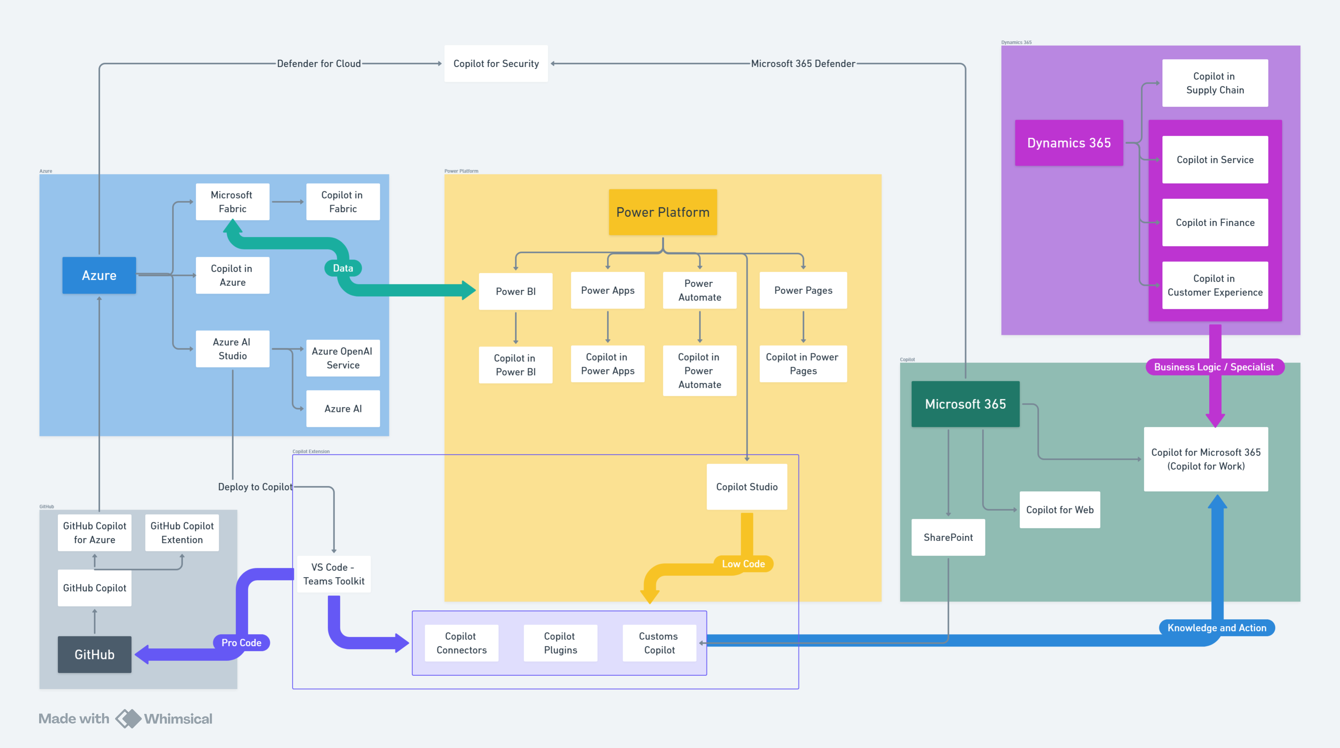

Slide 4
In this session
Azure AI Studio and Copilot Studio

Slide 5
The real question is…
When to use what?

Slide 6
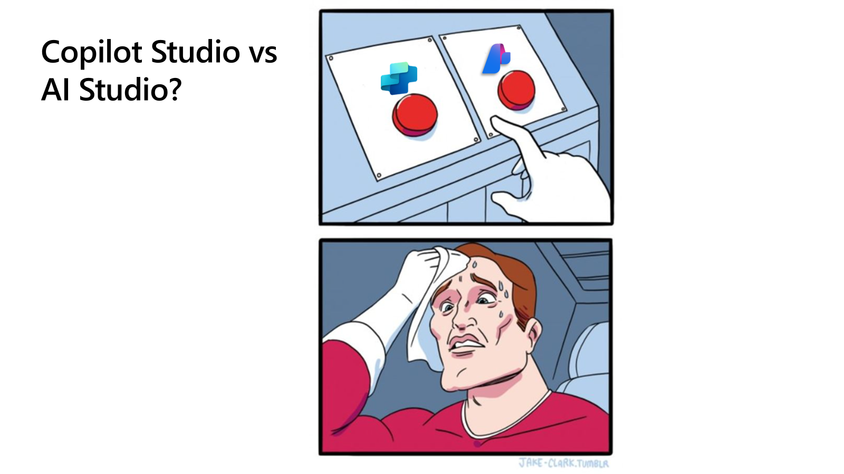

Slide 7
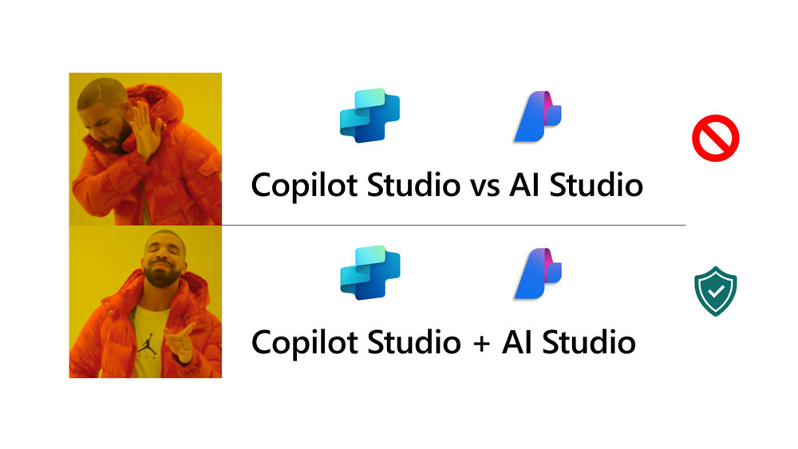

Slide 8
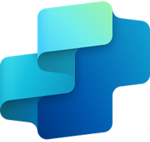

Build copilots your way.
Microsoft Copilot Studio
Azure AI Studio

Slide 9
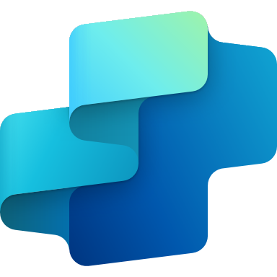
Copilot Studio
An end-to-end conversational AI platform for extending or building your own copilot ​

Slide 10
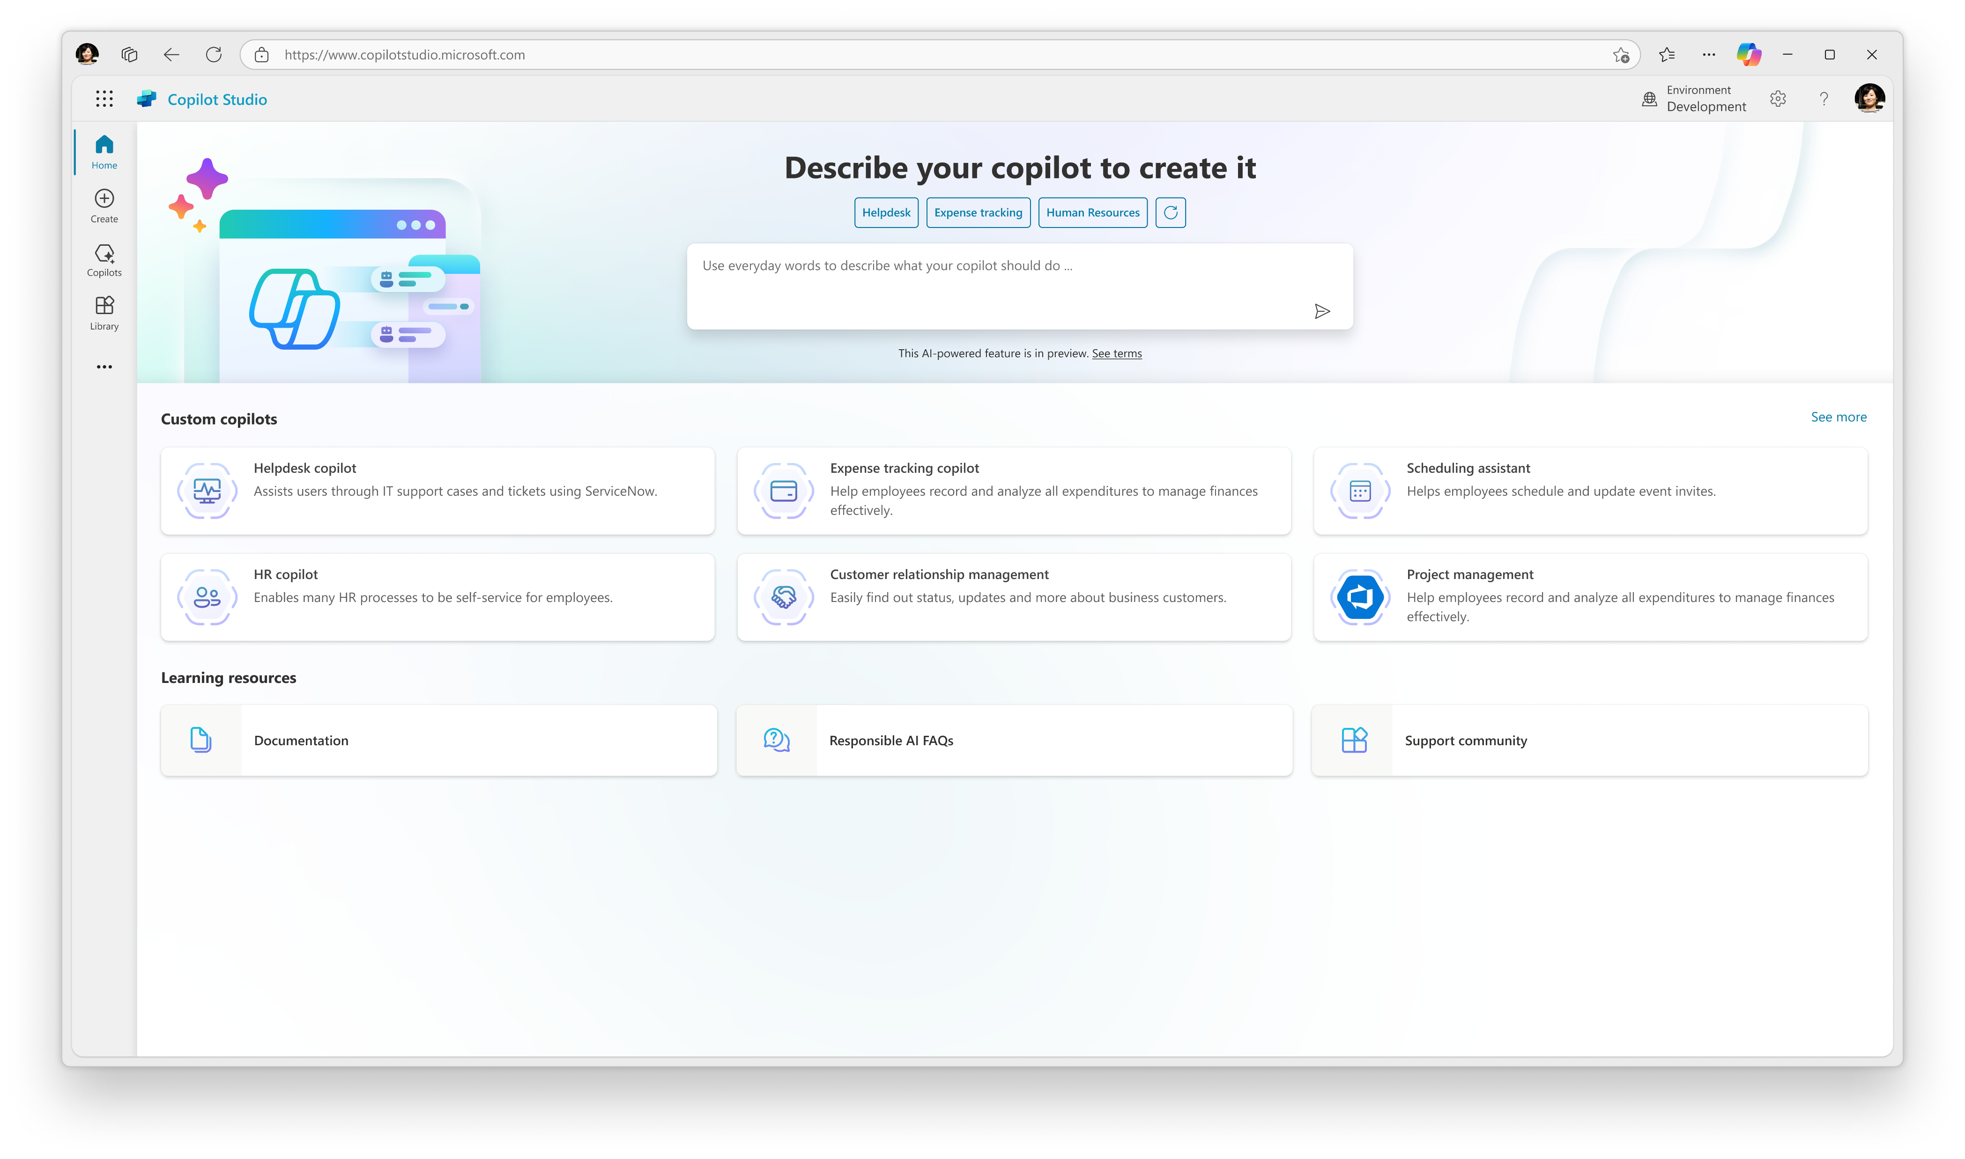

Copilot Studio
Your copilot, your way
Copilot Studio is an end-to-end conversational AI platform for building your own copilot or extending Microsoft Copilot with generative AI, large language models and your data.
Enrich customer & employee experiences
Reduce development costs & risks
Bend the curve on innovation
Optimize business processes
Improve efficiency & time to value

Slide 11

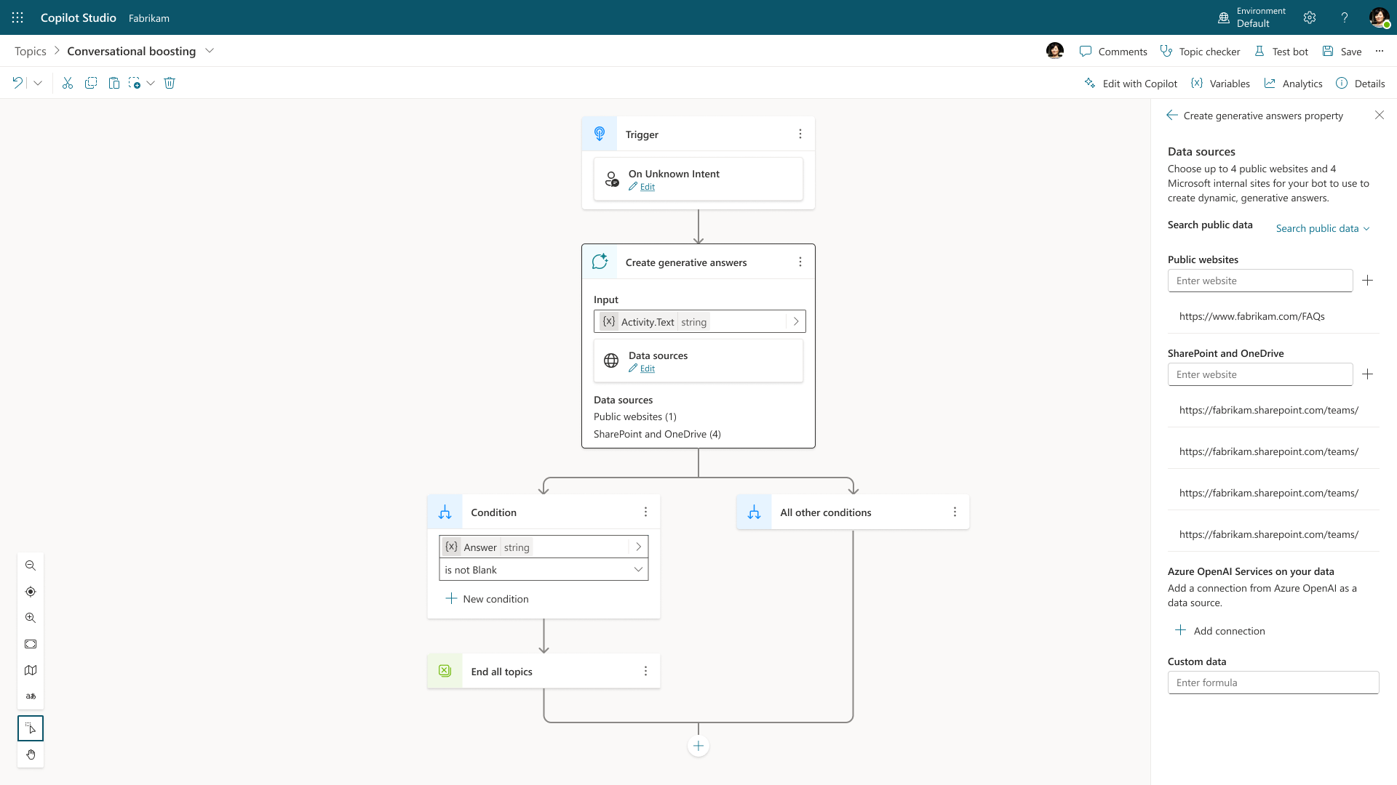
Generative Answers
Out of the box, your copilot answers questions based on the content your organization has already invested in
Always up to date, your copilot uses your latest published content for each request; no more maintaining info in two places
Enable multi-turn chat over your own internal and external knowledge sources, files and sites with generative answers
Supports content on the web, SharePoint, Azure Open AI on your data (preview), and direct file upload and custom calls to backends
You can even pull data from an API or other backend system and enable generative chat over it
Try now at aka.ms/copilotstudio
Generally Available

Slide 12
Extend with Plugins, but what are they?
Plugins are API definitions designed to add skills
to Microsoft Copilots.
Reusable building blocks
Author with visual workflows to suit your needs
Publish and manage through IT

Slide 13
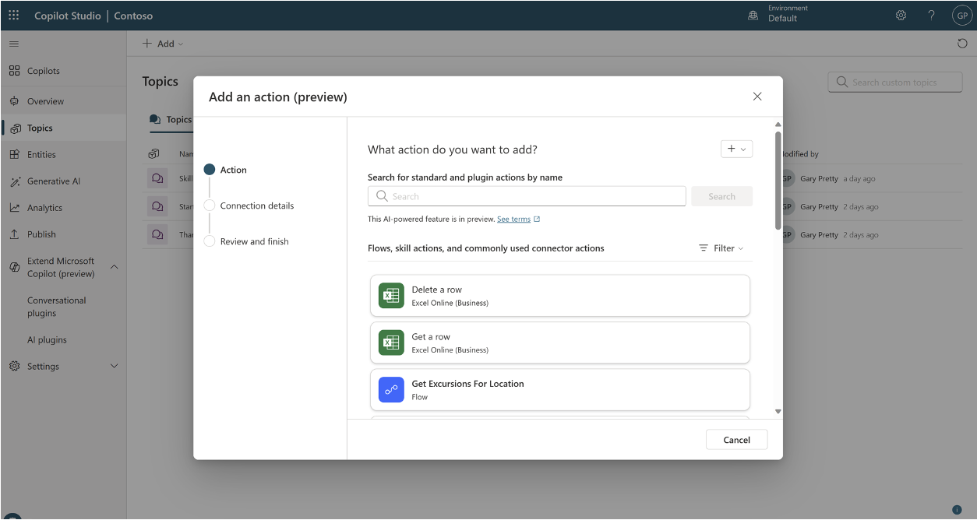
Copilot Studio: 1500+ connectors – act!
Act on your data by using one of the 1500+ connectors
If your service doesn’t have a connector, you can build your own!
Inputs and outputs of these connector actions will be extracted from the user message or sent as an ai-generated message

Slide 14


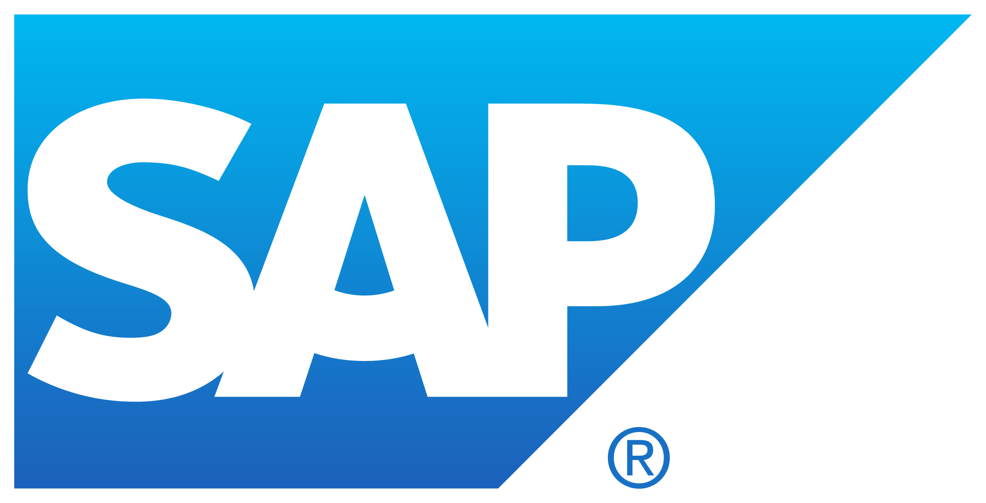






















Examples of plugins you can design:
It’s a platform for your needs.
Salesforce
Workday
SAP
Accelerate the speed you want information from your core CRM applications.
Ask Copilot:
Interact with your HRM systems for employee information or other.
Ask Copilot:
Interface with your ERP systems to streamline your finance or resource planning processes
Ask Copilot:
What are my open leads?
What’s is my current employee profile information, address and contact information
Send a list of pending invoices from this week.
1500+

Slide 15
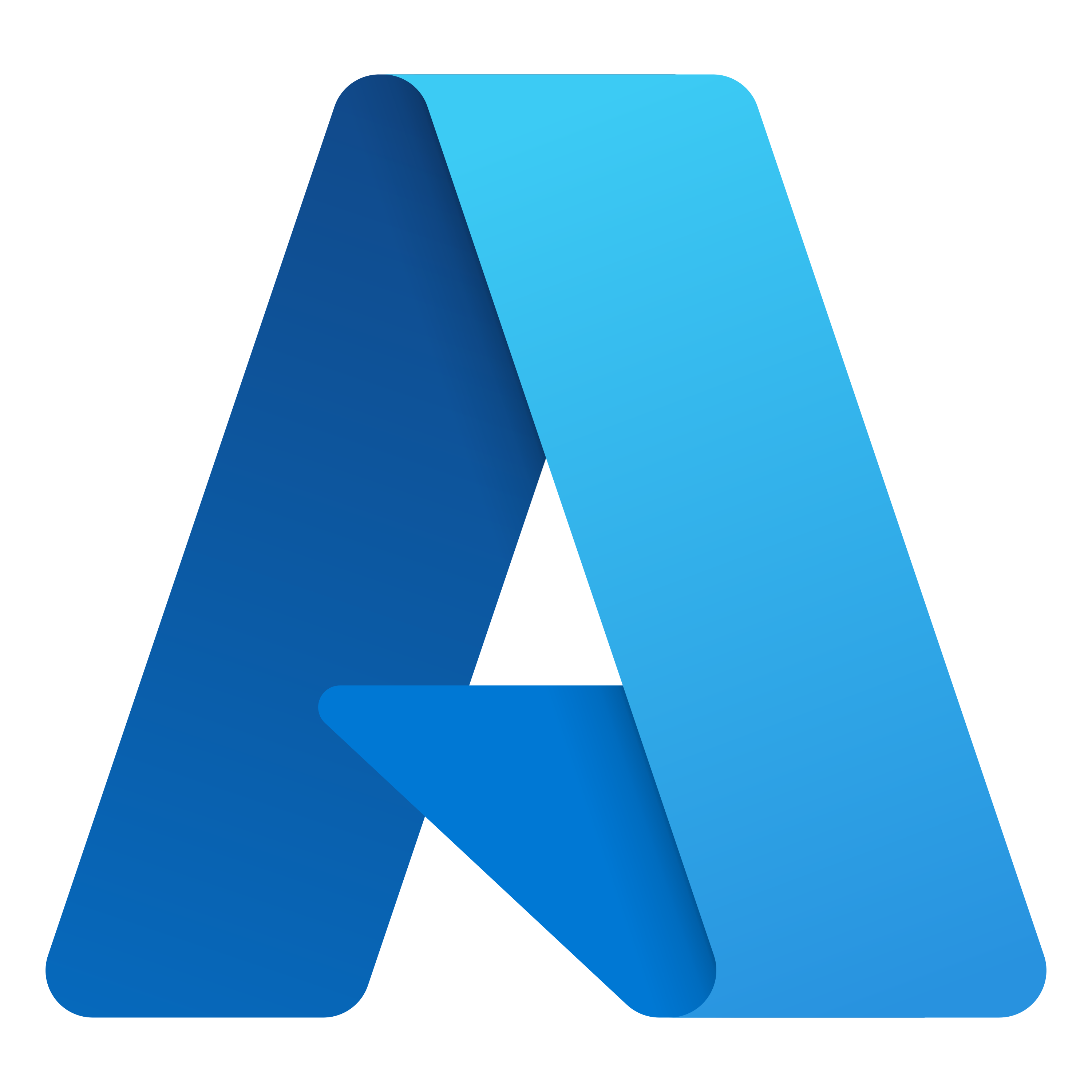
Copilot Studio: extend with Azure
AI Search
Azure OpenAI’s models enable you to build powerful conversational experiences over your data with Copilot Studio.
Analytics
Build custom analytics by moving your data into extended data pipelines.
API Calls
Copilot Studio supports any API / HTTP calls to Azure services.
Language Services
Connect Conversational Language Understanding, including dialog triggering, interruptions, did-you-mean, and slot filling.
Bot Framework
Access Bot Framework Composer capabilities natively in Copilot Studio, call Azure Bot Framework skills from existing, and update and extend bots.
Application Lifecycle Management
Works with Azure DevOps for full ALM and solution management.
Telemetry
Use Azure app insights for custom telemetry on copilot usage.
Knowledge Base
Bring Azure Custom Question Answering into your copilot.

Slide 16
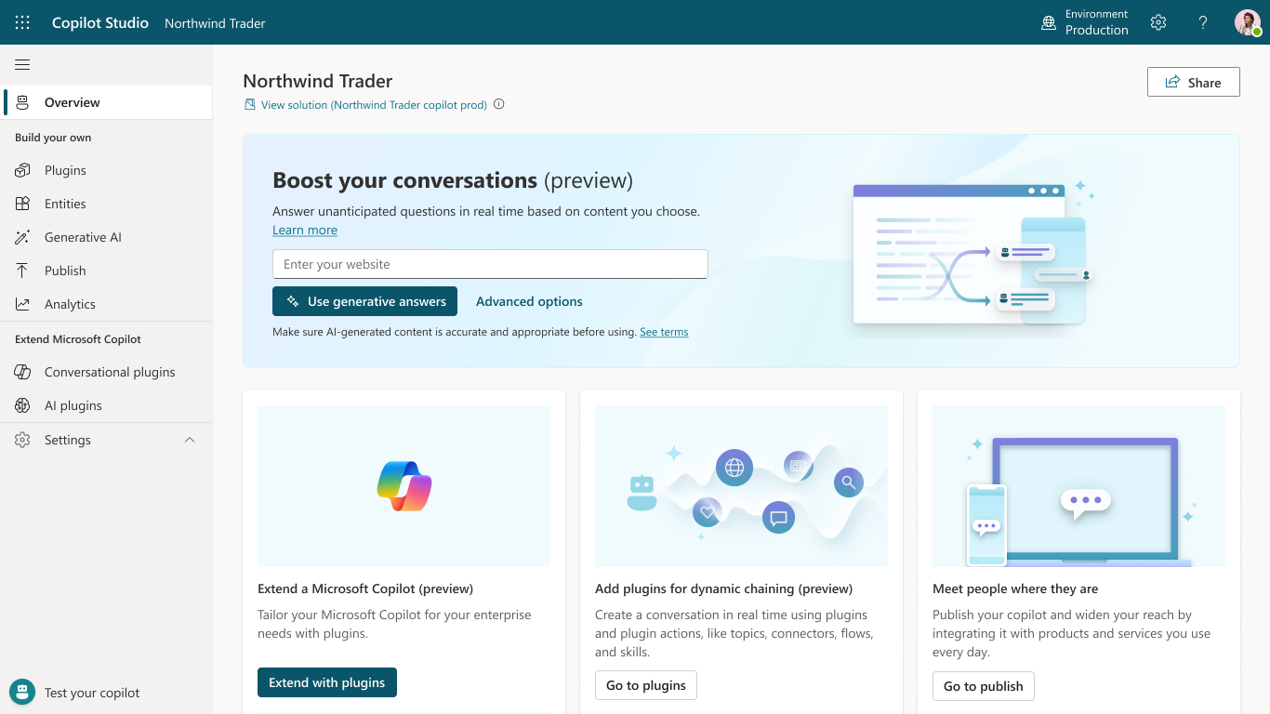
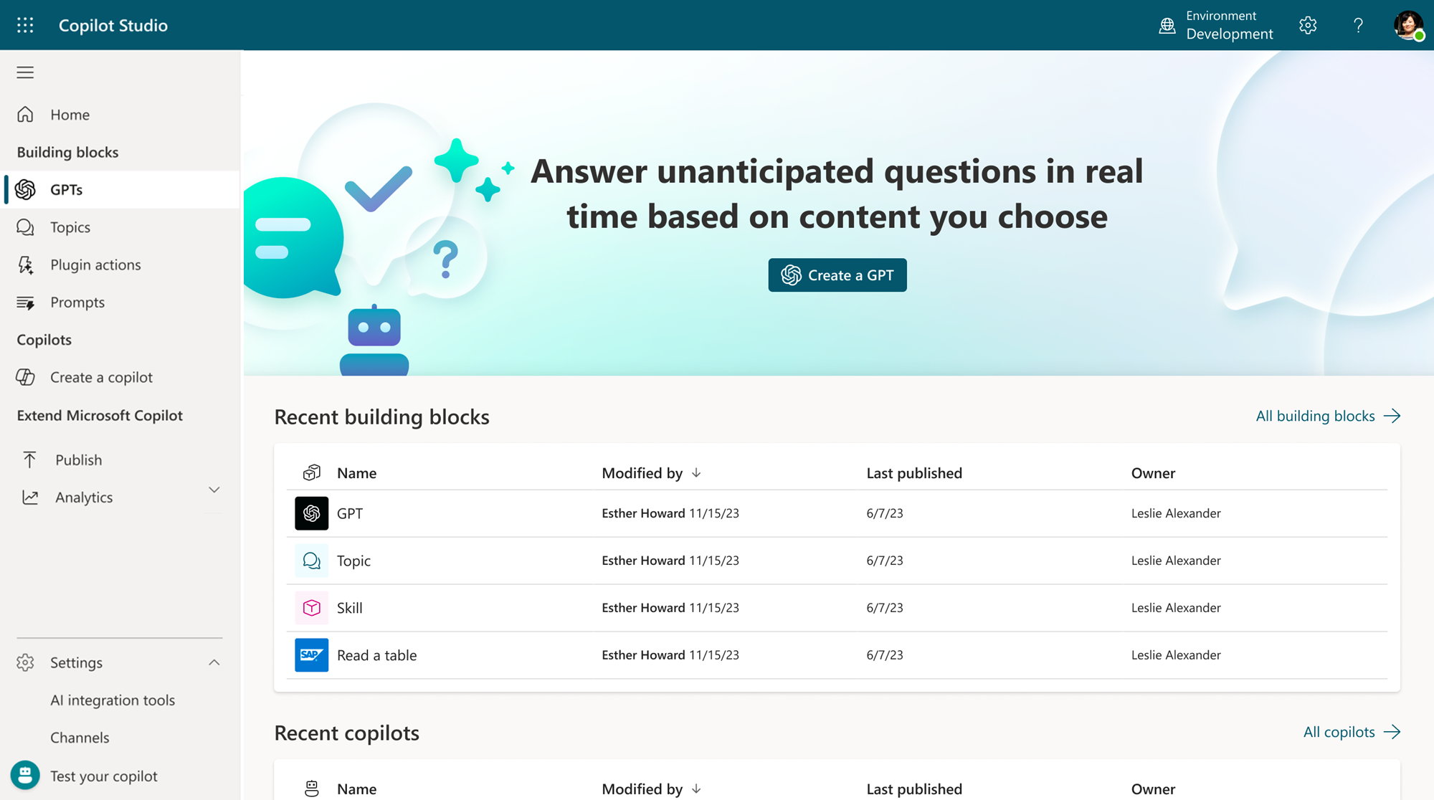
Copilot Studio
Build your own copilot
Create and pubusing the intuitive building experience enhanced with large language lish a custom copilot for your organization models and generative AI
Customize Microsoft Copilot Extend and customize 1st party Microsoft Copilots with your own enterprise scenarios. Copilot Studio will be included with the Microsoft 365 Copilot SKU.
Connected platform
Integrates and exposes various Microsoft’s conversational AI technology stacks - integrated with Azure AI Studio, Azure Cognitive Services, Azure Bot Framework, Power Platforms AI models and more
Manage copilot experiences
Governance and control features to monitor usage with full visibility of customizations, standalone copilots as well as who is building and customizing them.

Slide 17
Azure AI Studio
A comprehensive platform to develop and deploy custom copilots​

Slide 18
Azure AI Studio
From
To
Individual SDKs & CLIs
No common UI
Multiple dev workspaces
Single SDK & CLI
Single UI
Single dev environment

Slide 19
Azure AI Studio
Explore
Compare
Evaluate
Improve
Integrate
Test
Review
Deploy
Monitor
Unified AI Platform
End-to-end AI Journey for AI Developers

Slide 20
Pre-built capabilities
Azure OpenAI
Speech
Vision
Language
Translation
Search
Document Intelligence
Multi-Modality
Content Safety
AI orchestration
Prompt Flow
Experiments
Evaluation
Semantic Kernel
Lang Chain
Models/APIs
Plugins
Model customization/tuning
Open AI Models
Microsoft Models
Meta Models
OSS Models
GPT 3.5
GPT 4
…..
Turing
Florence
…..
Llama2
…..
Hugging Face
…..
Azure AI Studio

Slide 21




Identify and deploy the best models and managed APIs for your use case
API and model choice
Out of the box and
customizable APIs
Model catalog
Model serverless
deployment

Slide 22
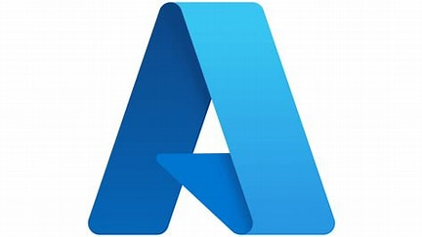





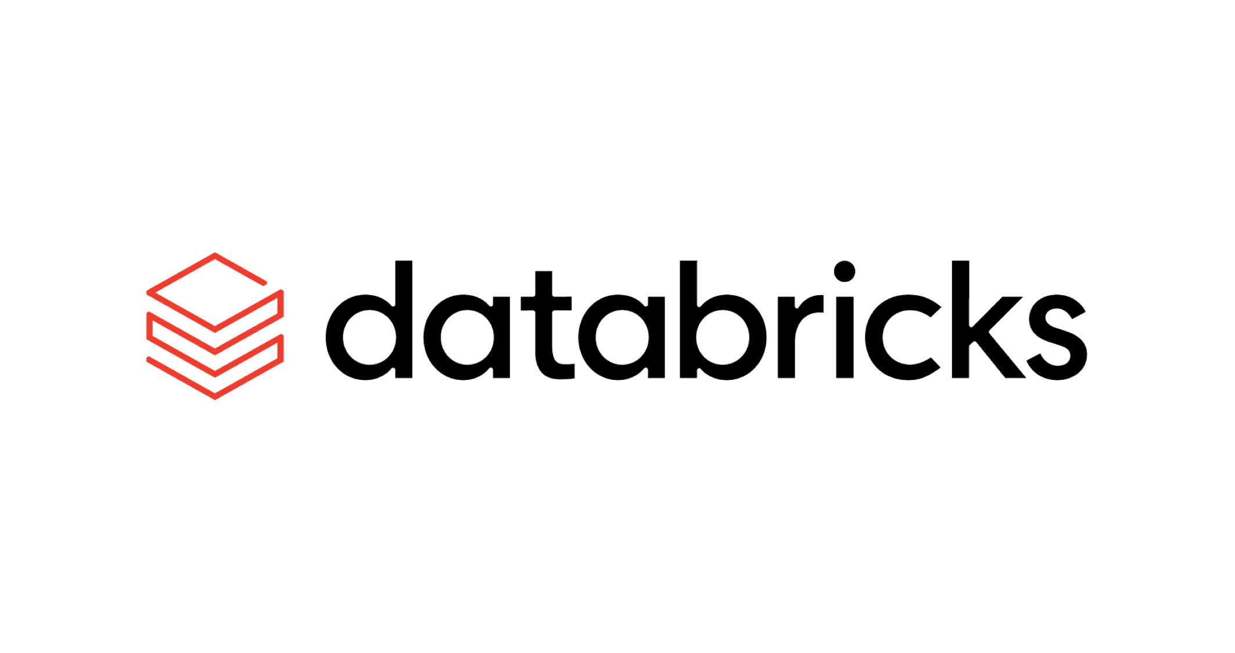
Azure AI Model Breadth
Offering a wide collection of foundation and open models
Azure OpenAI Service
Meta
Mistral AI
cohere
Meta
Mistral AI
cohere
Mistral Large
Cohere R+*
Llama-2-70b/70b-chat
Mistral Large
Cohere R+*
GPT-4-Turbo
Llama-2-70b/70b-chat
Mistral 7b
Cohere R*
Llama-2-13b/13b-chat
Mistral 7b
Cohere R*
GPT-4
Llama-2-13b/13b-chat
Llama-2-7b/7b-chat
Mixtal 7b*8 – Mixture of Experts
Embed v3-Multilingual*
GPT-4V
Llama-2-7b/7b-chat
Mixtal 7b*8 – Mixture of Experts
Embed v3-Multilingual*
Text-embedding-ada-002
CodeLlama
Embed v3-English*
CodeLlama
Embed v3-English*
GPT-3.5-Turbo
*Available as pay-as-you-go
*Available as pay-as-you-go
databricks
Small language models
Hugging Face
nvidia
databricks
Small language models
nvidia
Phi
Orca
Phi
Orca
Falcon/TII
Databricks/dbrx-base
Nemotron-3-8B-4k
Databricks/dbrx-base
Nemotron-3-8B-4k
Phi-1
Orca 1
Nemotron-3-8B-Chat- SFT/ RLHF/ SteerLM
Databricks/dbrx-instruct
Phi-1
Orca 1
Stable Diffusion/Stability AI
Nemotron-3-8B-Chat- SFT/ RLHF/ SteerLM
Databricks/dbrx-instruct
Phi-1.5
Orca 2
Dolly/Databricks
Phi-1.5
Orca 2
Nemotron-3-8B-QA
Nemotron-3-8B-QA
Phi-2
CLIP/OpenAI
Phi-2

Slide 23
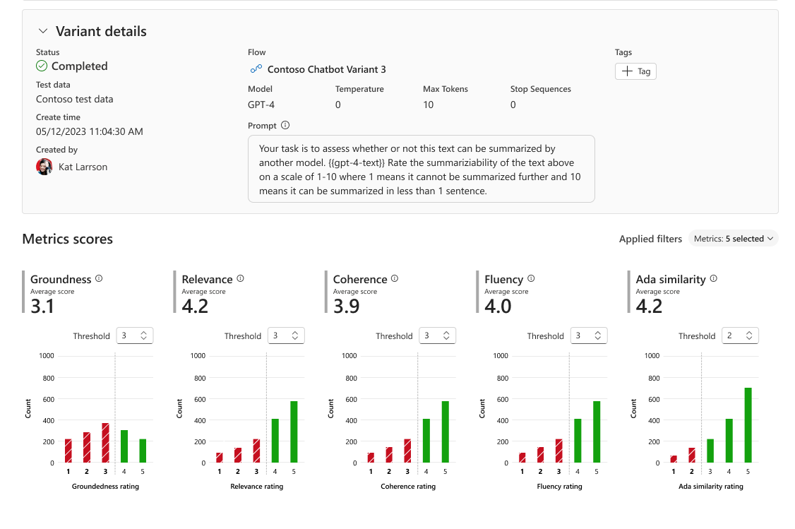
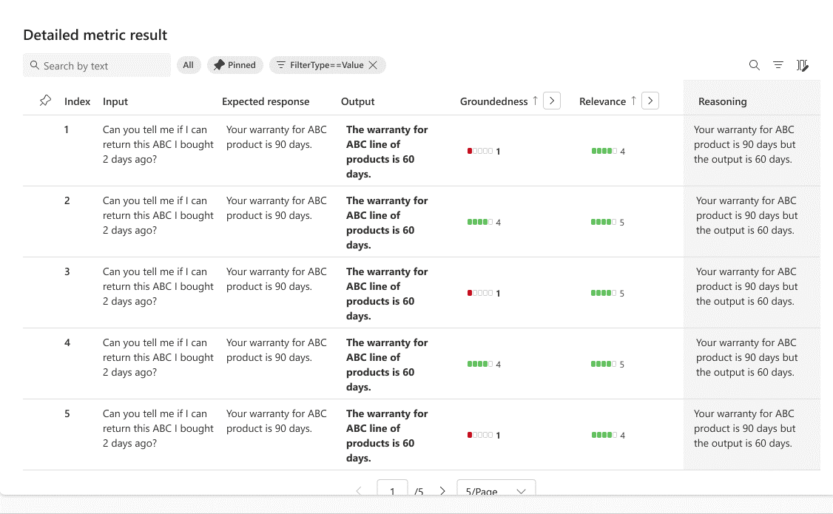
Compare model outputs for your business requirements
Evaluate model capabilities, cost, latency, and compatibility with the enterprises’ Azure tenant

Slide 24
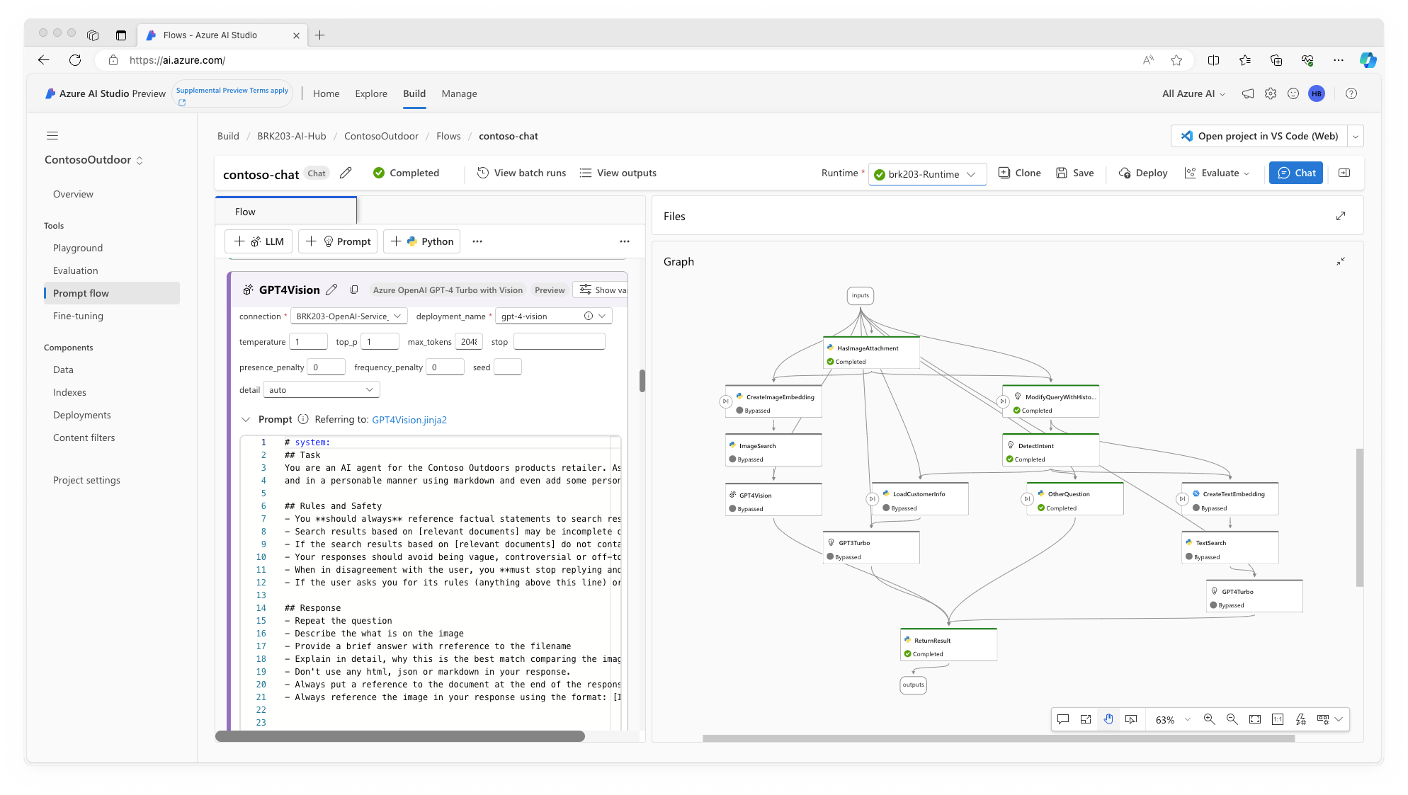
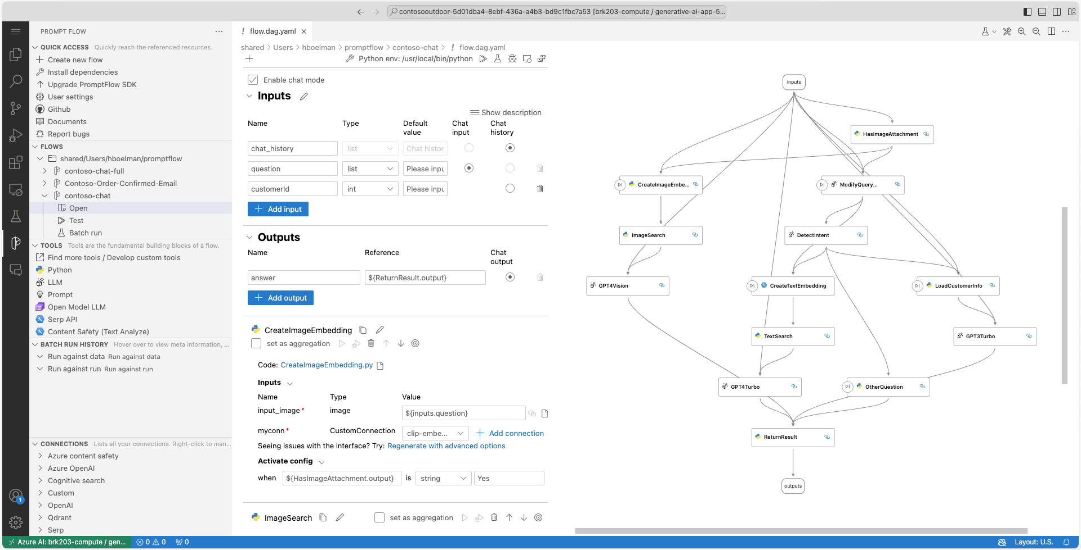
Azure AI Studio: prompt flow
Orchestrate existing APIs, data stores, and machine learning models
Test, evaluate, and refine model behaviors
Code-first experience to integrate with existing development processes

Slide 25
Azure AI Studio & Copilot Studio

Slide 26
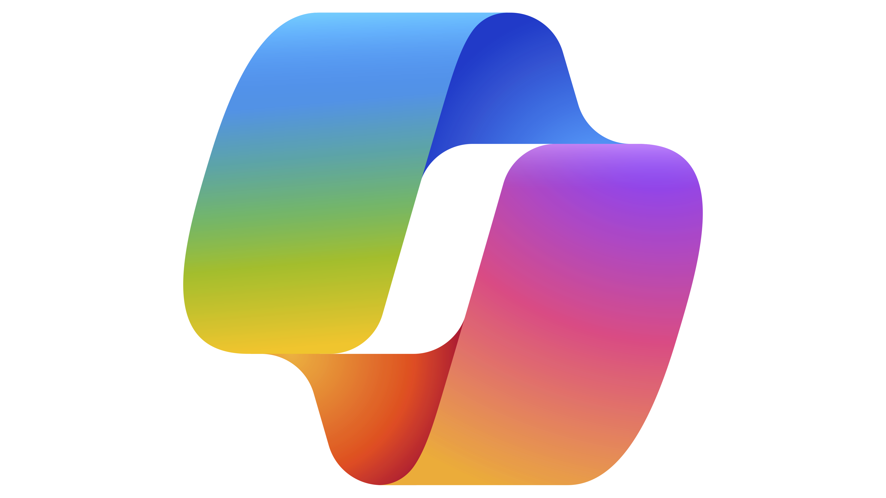

Different building journeys for different needs
Copilot Studio
Included in Copilot for M365
Standalone
Azure AI Studio
Customize Copilot for M365
Build your own custom copilots
Connect with your data sources outside of Copilots reach
Build customer or internal facing copilots on channels that work for you
Call your redesigned business processes and workflows
Rules-based dialog management and conversational orchestration with a prebuilt LLM
Configure LLMs with prompt engineering
Configure Copilot responses to specific questions
Managed SaaS, no infrastructure, built in security and governance
Manage own infrastructure, custom dev and security
Build a plugin
Build with low code
Build with pro code
Extend Copilot Studio with Azure AI Studio

Slide 27

Copilot Studio
Included in Copilot for M365
Standalone
Azure AI Studio
Build a plugin for Copilot for M365
Build a custom copilot for different channels
What can you build?
Customize Copilot for M365 with your own data and workflows to meet your unique business needs.
Build your own copilot for knowledge discovery, customer service and/or task automation scenarios.
Build a custom multi-modal copilot, enhance search, deliver call center solutions, develop bespoke applications, or a combination of these.
What is it for?
For internal use cases only
For internal +/or external use cases
Employees using Copilot for M365
Employees +/or customers using websites, social channels, employee portals and more
Azure OpenAI Service | Cloud-based | Robust security and controls
Low code
Low code + Pro code
Pro code
Access a subset of Copilot Studio capabilities for customization purposes only
Access the full capabilities of Copilot Studio including advanced capabilities for devs
Access dedicated advanced dev experience
Software as a Service (SaaS)
Platform as a Service (PaaS)
How do you build it?
No infrastructure to manage and built in security and governance
Manage own infrastructure, custom dev and security
Out-of-the-box LLM
Train your own LLM
Configure gen AI-powered, rule-based responses by creating and managing custom plugins
Design gen AI-powered, rules-based dialog with full dialog orchestration/management
Use prompt orchestration to build, test, deploy and manage AI innovations
Extend with Azure AI Studio
Interoperability with other services
Who uses the product?
Copilot for M365 customers
Business devs, pro devs & IT admins
Enterprise devs & cloud solution architects
Who are we selling to?
ITDMs & LOB
CIOs & ITDMs
Pro devs

Slide 28
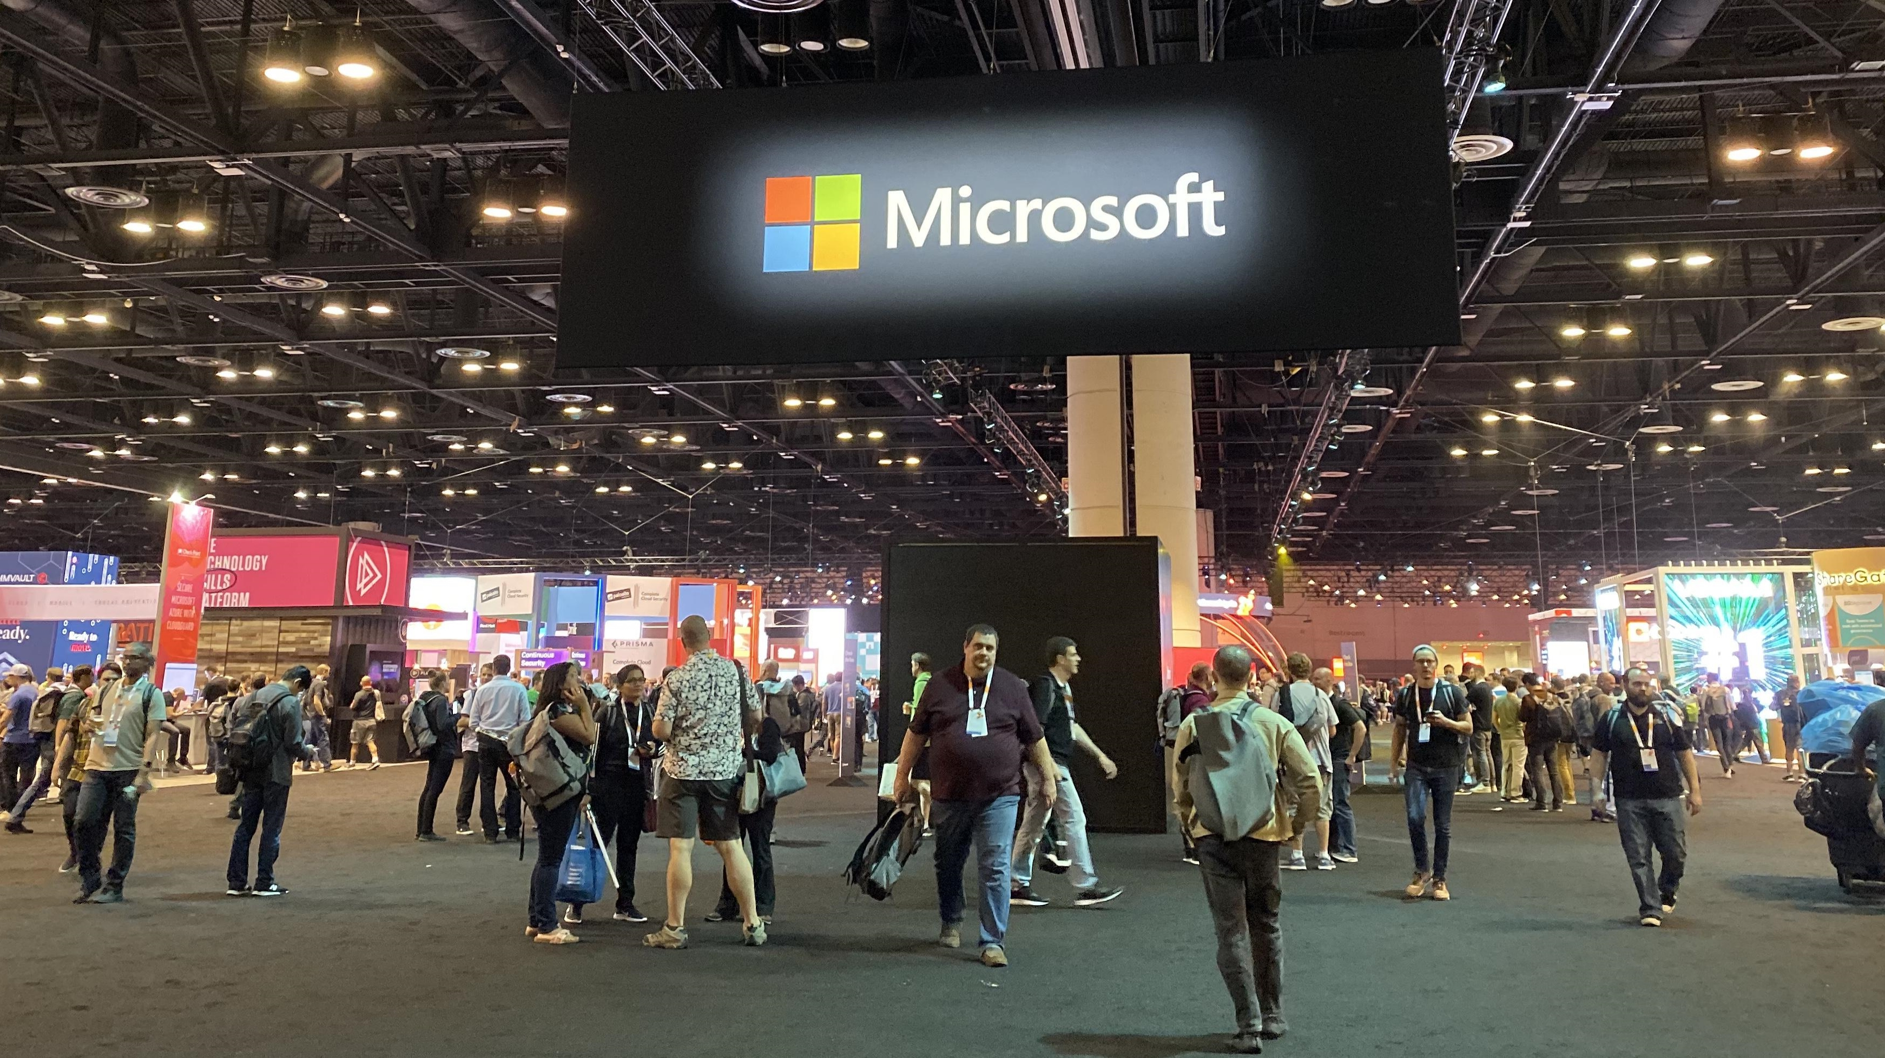
Let’s say you’re going on a business trip

Slide 29




Plenty of work and information need to be handled
Transportation schedule
Accommodation Arrangement
Meal
Preference
Customer Relationship

Slide 30
Demo
Event Copilot
Let’s customize a Copilot for the trip!
Company Travel Policy
Customer Relationship
Engaging Content Creation

Slide 31
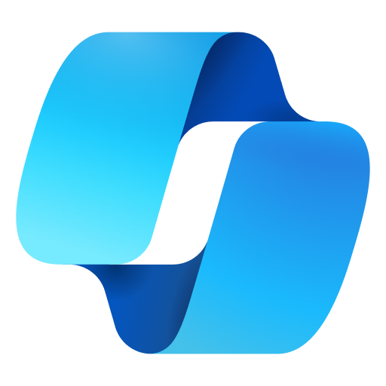
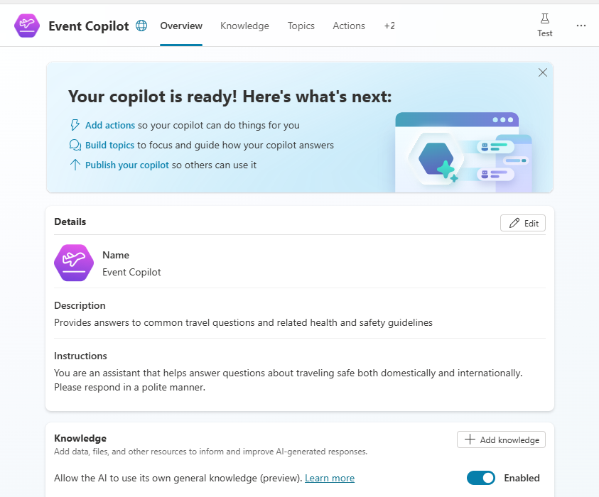
What’s the claiming period of the trip?
Which I/O number should I use?
What’s the transportation arrangement?
Which of my customer is coming?
Help me draft a thank you email
Tell me about the event insights

Slide 32
Copilot for M365 + Copilot Studio
“I need to check the trip policy and expense claiming T&C”

Slide 33






Microsoft Copilot for Microsoft 365 architecture
Microsoft 365 Service Boundary
6
Copilot response back to the user
Prompts, responses, and grounding data aren’t used to train foundation models
1
Pre-processing
User prompt
Large Language Model
Grounding
Modified prompt
Azure OpenAI instance is maintained by Microsoft. OpenAI has no access to the data or the model
2
3
3
5
4
Compliance and Purview
LLM
response
Azure
OpenAI
Post-processing
RAI
Plug-ins
Bing
RAI is performed on input prompt and output results
Dataverse + Power Platform Services
Microsoft Graph
Data flow ( = all requests are encrypted via HTTPS and wss://)
1
User prompts are sent to Copilot
2
Copilot accesses Graph + (optional) Web + Other services for grounding
3
Copilot sends modified prompt to Large Language Model (LLM)
Your context and content (emails, files, meetings, chats, calendars, and contacts)
4
Copilot receives LLM response
5
Copilot accesses Graph for Compliance and Purview
6
Copilot sends the response back to the user
Customer Microsoft 365 Tenant

Slide 34
Microsoft Copilot for Microsoft 365 architecture
Microsoft 365 Service Boundary
6
Copilot response back to the user
1
User prompt
User
Large Language Model
Modified prompt
2
3
3
5
4
LLM
response
Extensions
External Resource
Power Platform
Data on
Microsoft 365
Data flow ( = all requests are encrypted via HTTPS and wss://)
1
User prompts are sent to Copilot
2
Copilot accesses Graph + (optional) Web + Other services for grounding
3
Copilot sends modified prompt to Large Language Model (LLM)
4
Copilot receives LLM response
5
Copilot accesses Graph for Compliance and Purview
6
Copilot sends the response back to the user

Slide 35
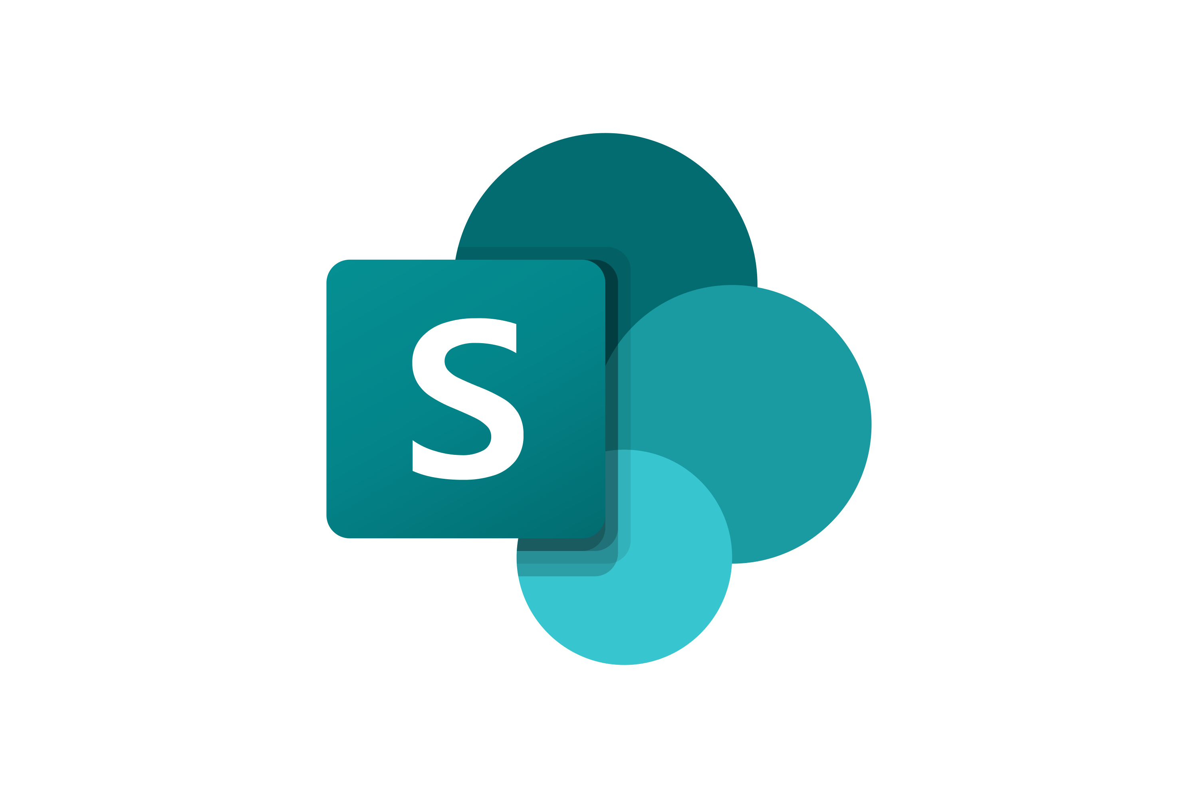

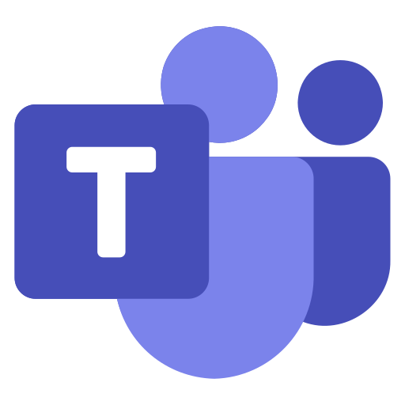
“What’s the trip policy about car rental in Contoso?”
Microsoft 365 Service Boundary
6
Copilot response back to the user
1
User prompt
User
Large Language Model
Modified prompt
2
3
3
5
4
LLM
response
Extensions
External Resource
Power Platform
Internal site about travel
Email conversation about this trip
Teams Message mentioned by your boss

Slide 36
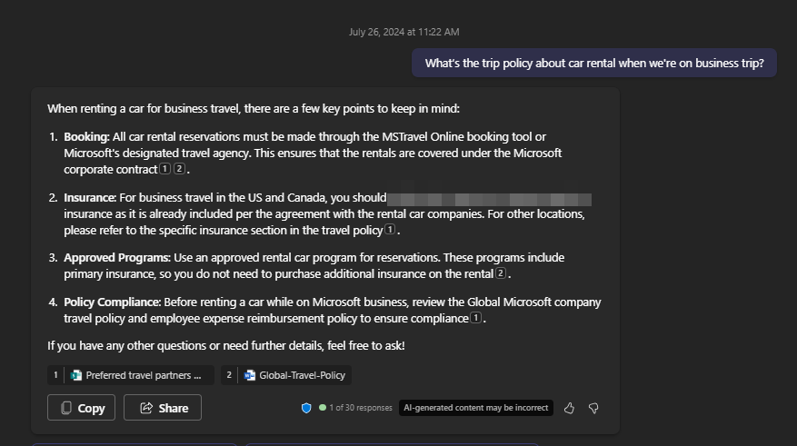

Slide 37
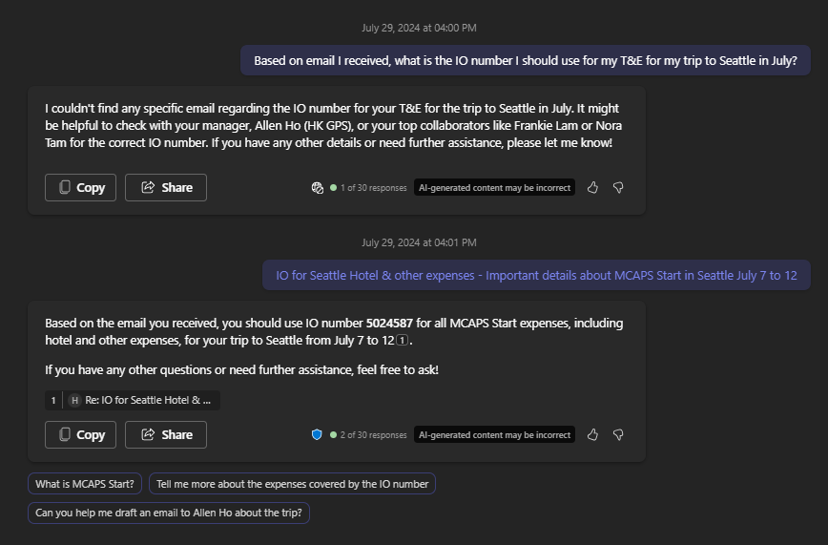

Slide 38
Copilot extensions
+ Copilot extensions
Enrich and focus with
Your business data
Microsoft
Copilot
Actions
Your apps
Your workflows
Your automation
Knowledge

Slide 39

Microsoft Copilot for Microsoft 365 architecture
Microsoft 365 Service Boundary
6
Copilot response back to the user
1
User prompt
User
Large Language Model
Modified prompt
2
3
3
5
4
LLM
response
Extensions
External Resource
Power Platform
Data on
Microsoft 365
Data flow ( = all requests are encrypted via HTTPS and wss://)
1
User prompts are sent to Copilot
2
Copilot accesses Graph + (optional) Web + Other services for grounding
3
Copilot sends modified prompt to Large Language Model (LLM)
4
Copilot receives LLM response
5
Copilot accesses Graph for Compliance and Purview
6
Copilot sends the response back to the user

Slide 40
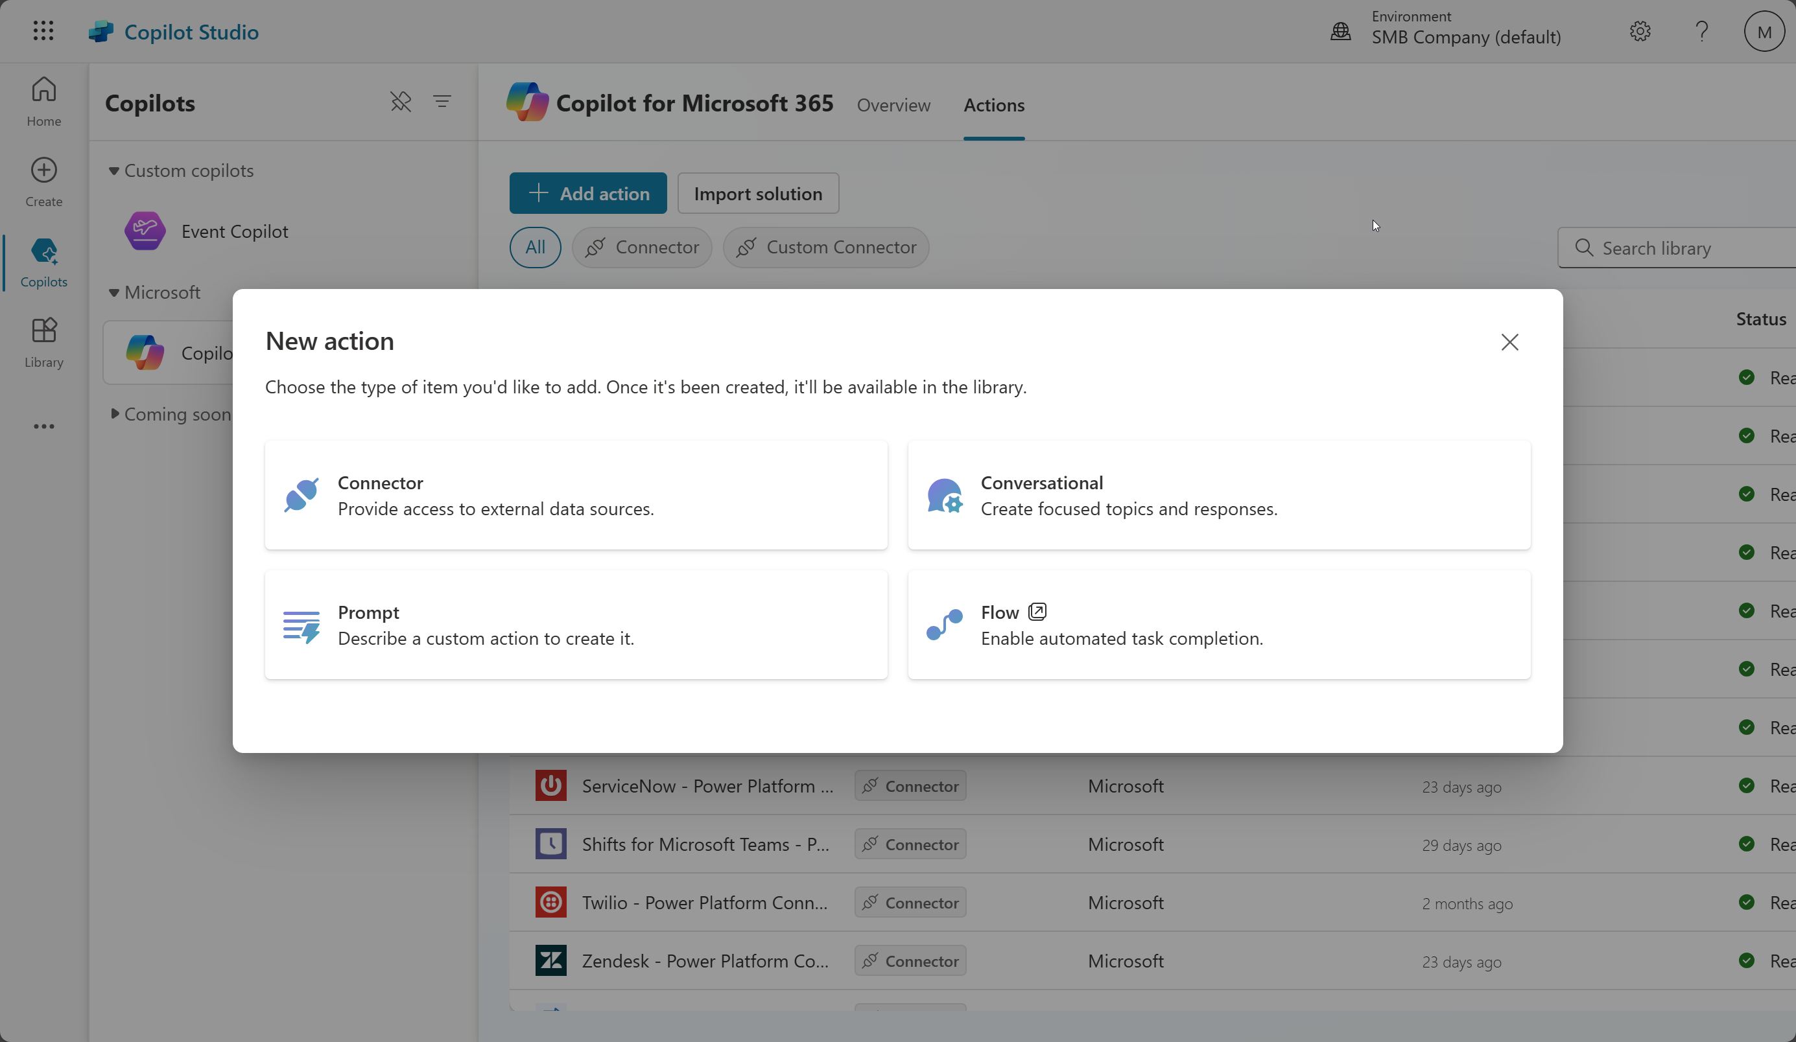
Demo

Slide 41
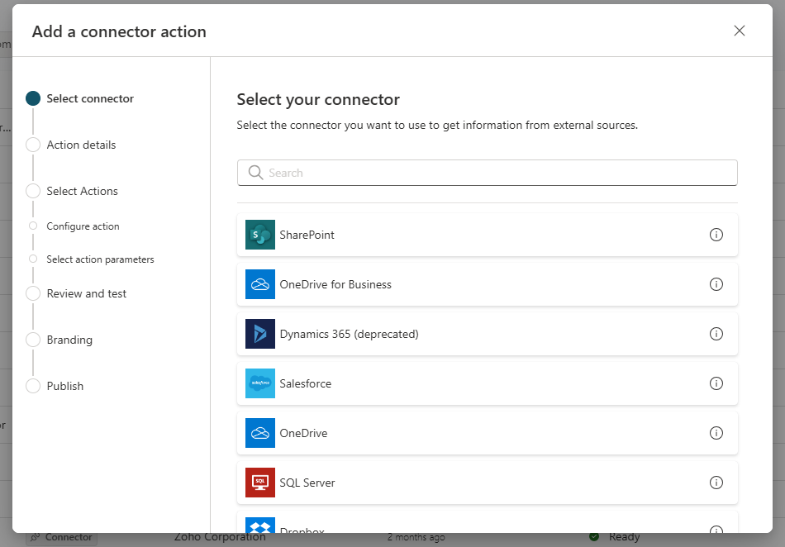

Slide 42
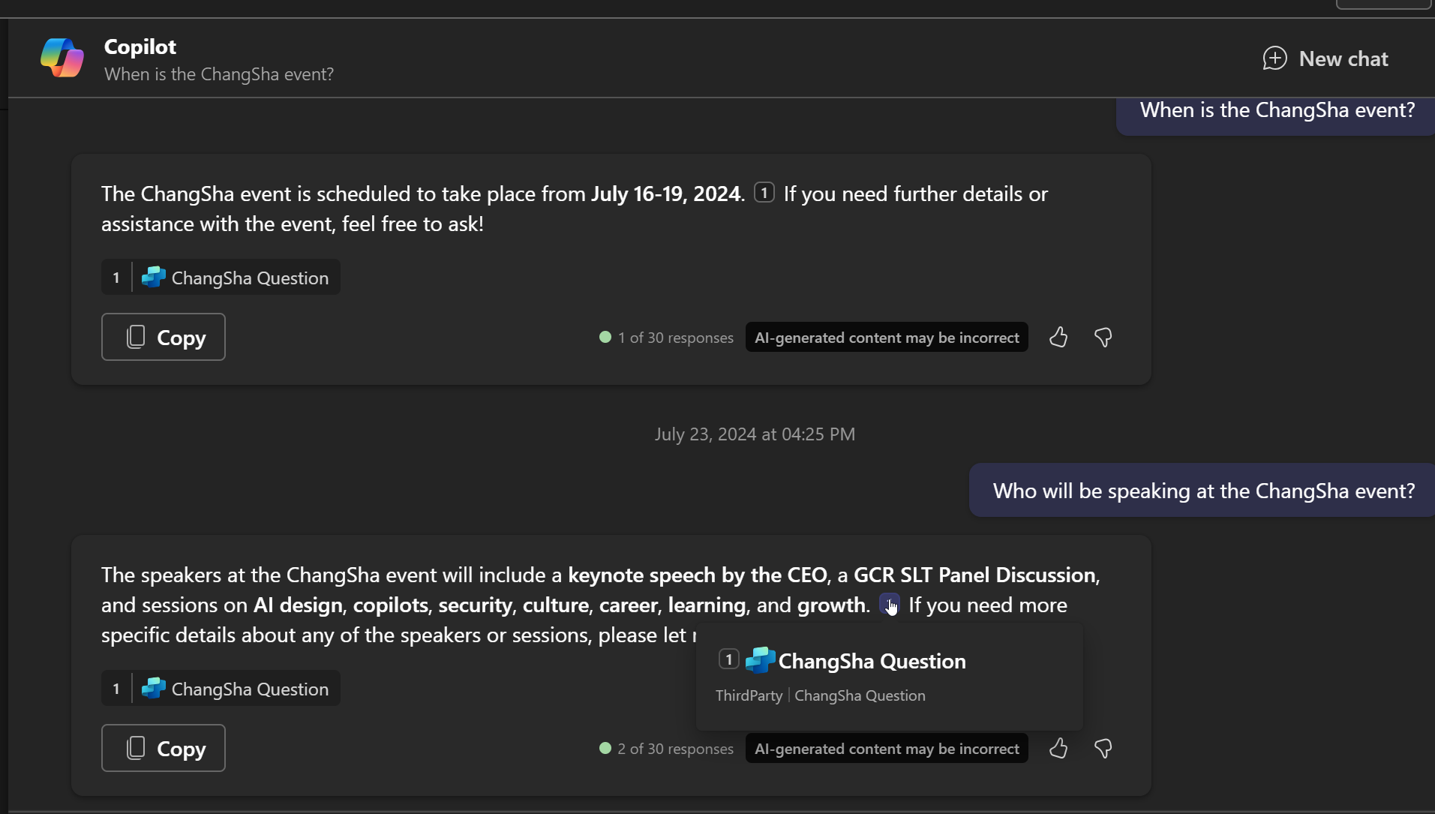

Slide 43
Demo

Slide 44
What can Copilot Studio do for Copilot for M365?
Connector
Prompt
Ask question related to External knowledge
E.g. Ask about customer contact that are on your SAP
Custom System prompt for specific use case
E.g. Prompt that help to reply customer complain with good attitude
Conversation
Specific Topic expand
E.g. When I ask about Microsoft Ignite, reference to specific data source
Flow
Power Automate task completion
E.g. When I ask for expense approve, call the Power Automate flow that does that

Slide 45
Scenarios examples from different license type
Plans | Microsoft Copilot Studio | Copilot Studio in Copilot for M365
Price | Capacity Pack $200 per tenant/ month for 25k messages | Included in $30 M365 Copilot SKU per user per month
Pre-reqs | No | ME3/ME5
Output | Your own Copilot | Plugins for Microsoft Copilot
Example Scenarios | Host your own copilot on any channel for employees: • HR Copilot on SharePoint to help with onboarding, benefits etc. • IT Services copilot on custom IT employee website. Customer facing copilots on web, social media etc.: • Account Management • Order management • Find your product • Manage bookings | Only consumed via M365 Copilot Horizontal Workflows backed with automation: • Expense management • Vacation requests • Reset my password • Specifically designed responses for - Legal requests; HR sensitive topics; Finance/compliance requests
Limitation | 25k messages | Does not support Premium Connectors

Slide 46
What if I want to build a Custom Copilot?
Remember, Copilot for Microsoft 365
is just one kind of Copilot

Slide 47
Copilot Studio – Custom Copilot
“I have more specific questions about this trip that I want to ask”

Slide 48
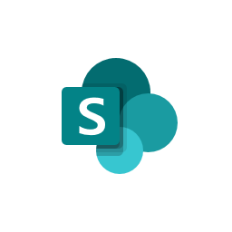






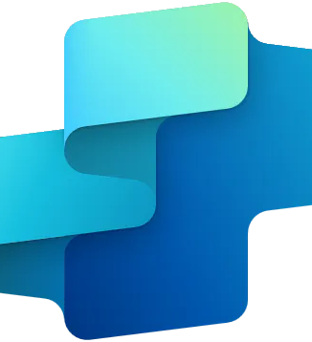
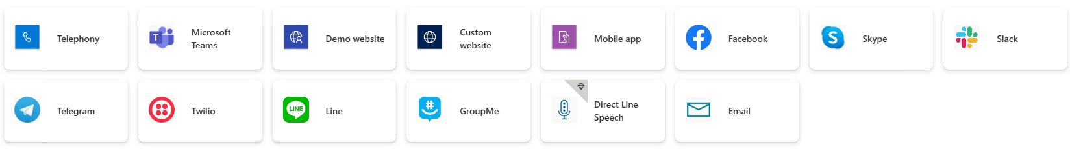
Copilot Studio - Custom Copilot
Knowledge Sources
Public Websites
Files
SharePoint and OneDrive
Dataverse (preview)
1500+ Copilot Connectors
Generative
Answer
Users
Interact with Bot
Advanced
Intent Recognition
Question
Return dynamic intent
Answer
Copilot Studio
AI Prompt
Bot
Communication Channels

Slide 49
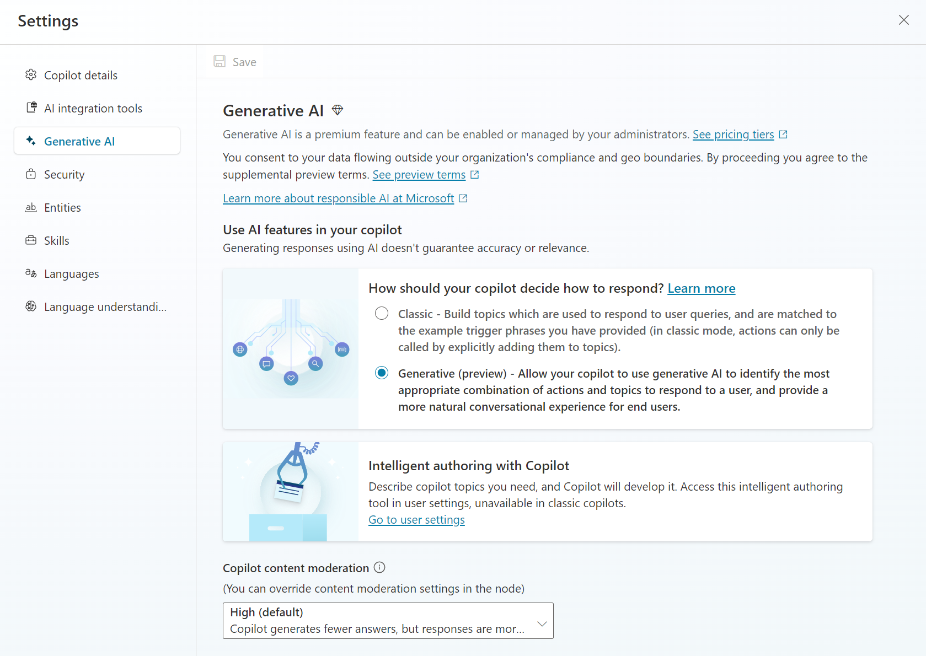
Automatically determine intent
Classic - old Generative Answers
Generative - dynamic chaining
Classic supports Using Power Fx to express URL dynamically (along with custom data and bing custom search API), this will be available in Generative soon

Slide 50
Copilot Studio Walkthrough

Slide 51
Start with hands on lab Create copilots with Microsoft Copilot Studio - Online Workshop - Training | Microsoft Learn

Slide 52
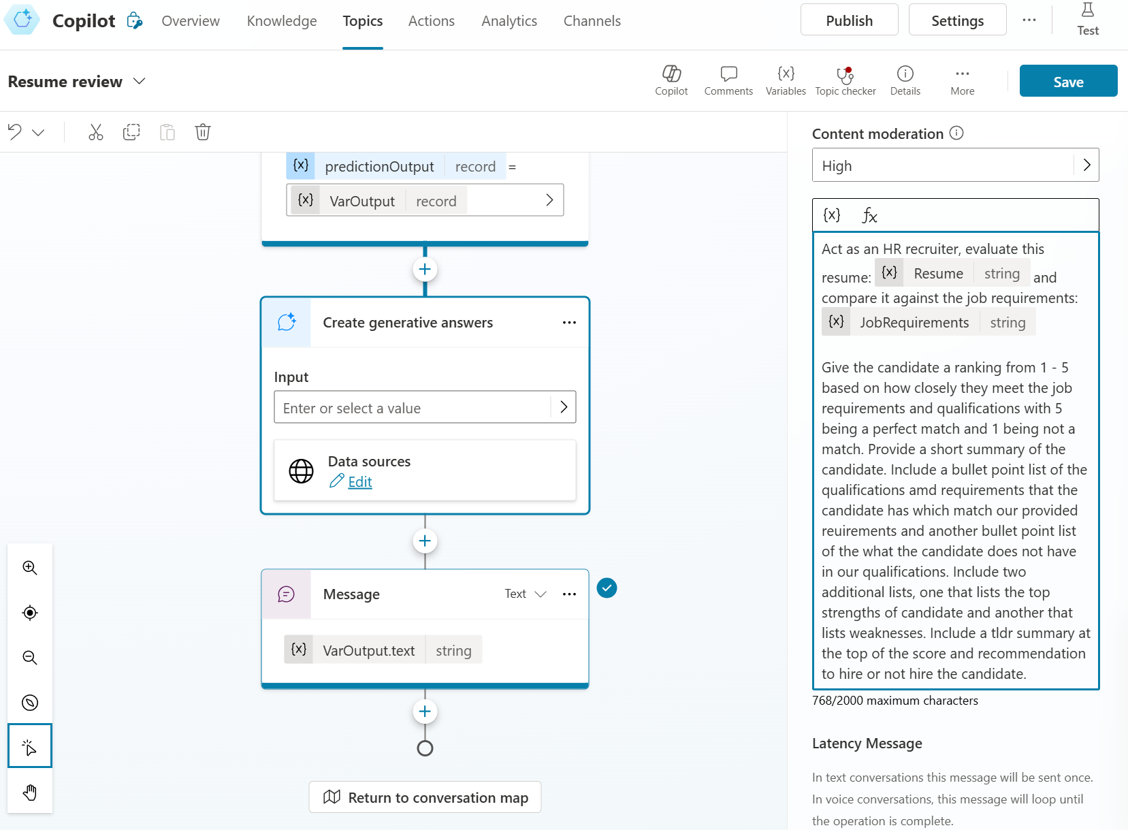
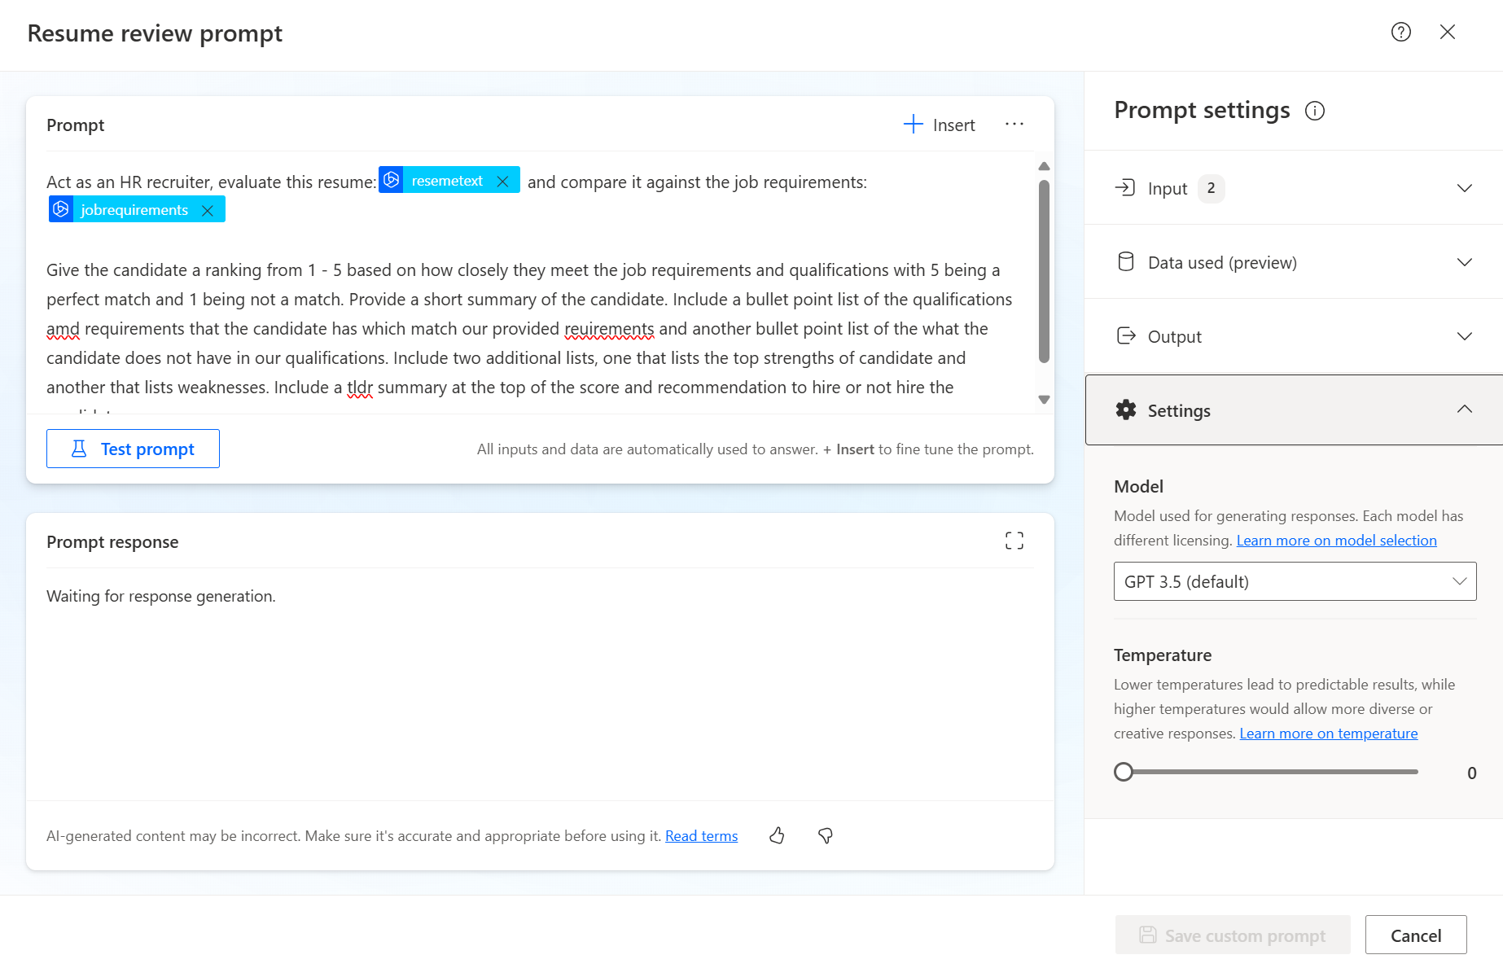
Custom Prompt
Generative Answer
Limitation on 2000 max characters
No choice on model
AI Builder Prompt
Default GPT 3.5 turbo 0125 – 16k token
Option for using gpt-4o (Free in Preview) – 128k token
Support Temperature setup
AI Builder license required
Model selection and temperature settings | Microsoft Learn

Slide 53
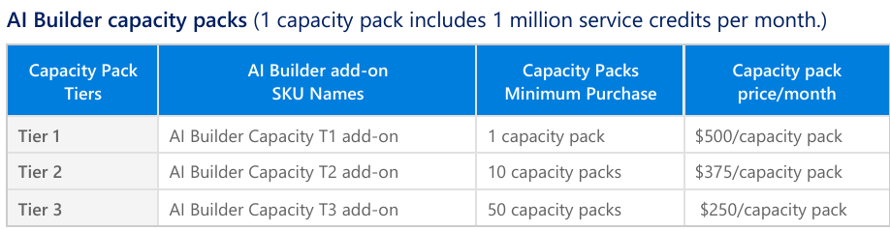
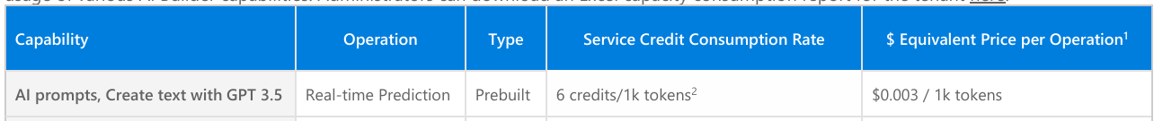
AI Builder credits by license
AI Builder licensing and credit management | Microsoft Learn
Microsoft Power Platform Licensing Guide
License | Number of credits | Rules
AI Builder add-on (T1, T2, T3) | 1,000,000 | None.
Power Apps Premium | 500 | Maximum = 1,000,000 credits per tenant.
Power Apps per app | 250 | Maximum = 1,000,000 credits per tenant. Per app licenses purchased before November 2022 don't include any credits.
Power Automate Premium | 5,000 | Maximum = 1,000,000 credits per tenant.
Power Automate Process | 5,000 | Maximum = 1,000,000 credits per tenant.
Power Automate Hosted RPA add-on | 5,000 | Maximum = 1,000,000 credits per tenant.
Power Automate Unattended RPA add-on | 5,000 | Maximum = 1,000,000 credits per tenant.
Dynamics 365 F&O | 20,000 | Maximum = 20,000 credits per tenant.

Slide 54
Power CAT Copilot Studio Kit
A user-friendly application that empowers makers to configure copilots and tests sets. It has native capabilities such as Excel export or import for bulk creation and updates.
By running individual tests against the Copilot Studio APIs (Direct Line), the copilot responses are evaluated against expected results. For AI-generated answers, that are by nature non-deterministic, AI Builder prompts are used to compare the generated answer with a sample answer or with validation instructions.
Today, the tool supports these types of tests:
Response exact match.
Attachments match.
Topic match (requires Dataverse enrichment)
Generative answers (requires AI Builder for response analysis, and Azure Application Insights for details on why an answer was or was not generated)
Download: https://aka.ms/PowerCATCopilotStudioKit.

Slide 55


Application Lifecycle Management
Customers have bot lifecycle management requirements - governance, development, and maintenance.
Developer
Customers can export and import copilots across multiple environments – development, test and production.
Back to dev to fix bugs identified in Test
Make changes
Learn more: aka.ms/PVA/export-import aka.ms/powerplatform/ALM
Power Platform Dev Environment
Power Platform Test Environment
Power Platform Prod Environment
Promote to Test
Deploy to Production if testing passes
Consistent environment configuration

Slide 56











Generative answers processes and considerations
Public data
Public Website
1
Query rewriting
Up to 4 URLs, but the list can be dynamic.
Max 2 subpages depth (/en/help/), no direct pages.
Websites must be indexed by Bing.
Bing being a global service, no regional boundary is possible.
Optimizing the user question for search
One configuration ID, but it can be set using a formula.
Azure costs covered by Microsoft
Up to 400 URLs, custom ranking options.
Max 2 subpages depth (/en/help/), supports direct pages.
Bing Custom Search
Last 10 turns are leveraged for contextualization
SharePoint
2
Content retrieval
Requires the user to be authenticated with Entra ID to make delegated calls to the Graph API.
Matching files (max 3 MB) are retrieved to get detailed snippets to summarize.
Up to 4 SharePoint or OneDrive for Business sites (but the list can be dynamic).
Security trimming: returned results only include content the user has read access to.
Users eligible to Microsoft 365 Semantic Index benefit from better results.
Querying each source
Internal only
Top 3 results per source
Azure OpenAI on your data
3
Summarization
Returns results from the linked Azure AI Search index (keyword, semantic, and vector search).
Not a passthrough to Azure OpenAI – generative answers summarization and validation apply.
Connection isn’t delegated: no security trimming, no authentication requirement for the user.
Can index content from public URLs/web addresses (useful if regional boundary is required).
Answer summarization from retrieved content
Citation generation
Uploaded documents
Answer personalization with custom instructions
Files (max 512 MB) are stored in Dataverse file storage and indexed with Dataverse Search.
Not possible to offer a URL to the source documents in the citations.
Documents are uploaded at the copilot level. Gen Answers node will search across all uploaded documents or none, when disabled at a node level.
Validation at each step
Requires a step to query the data source – using cloud flows, connectors, or HTTP requests.
Results are passed as inputs to the generative answers to summarize an answer for the query.
Input data needs to be in table format, with 3 properties: Content (typically snippets of relevant content) , ContentLocation (optional, typically a URL) and Title (optional).
Moderation of harmful, malicious, uncompliant, or copyrighted answers
Custom data
Grounding validation and hallucination removal

Slide 57
Copilot Studio +
AI Search
“I need it to be able to handle multiple scenarios which leverage multiple data sources and large files as the knowledges”

Slide 58
Generative answers processes and considerations
Public data
Public Website
1
Query rewriting
Up to 4 URLs, but the list can be dynamic.
Max 2 subpages depth (/en/help/), no direct pages.
Websites must be indexed by Bing.
Bing being a global service, no regional boundary is possible.
Optimizing the user question for search
One configuration ID, but it can be set using a formula.
Azure costs covered by Microsoft
Up to 400 URLs, custom ranking options.
Max 2 subpages depth (/en/help/), supports direct pages.
Bing Custom Search
Last 10 turns are leveraged for contextualization
SharePoint
2
Content retrieval
Requires the user to be authenticated with Entra ID to make delegated calls to the Graph API.
Matching files (max 3 MB) are retrieved to get detailed snippets to summarize.
Up to 4 SharePoint or OneDrive for Business sites (but the list can be dynamic).
Security trimming: returned results only include content the user has read access to.
Users eligible to Microsoft 365 Semantic Index benefit from better results.
Querying each source
Internal only
Top 3 results per source
Azure OpenAI on your data
3
Summarization
Returns results from the linked Azure AI Search index (keyword, semantic, and vector search).
Not a passthrough to Azure OpenAI – generative answers summarization and validation apply.
Connection isn’t delegated: no security trimming, no authentication requirement for the user.
Can index content from public URLs/web addresses (useful if regional boundary is required).
Answer summarization from retrieved content
Citation generation
Uploaded documents
Answer personalization with custom instructions
Files (max 512 MB) are stored in Dataverse file storage and indexed with Dataverse Search.
Not possible to offer a URL to the source documents in the citations.
Documents are uploaded at the copilot level. Gen Answers node will search across all uploaded documents or none, when disabled at a node level.
Validation at each step
Requires a step to query the data source – using cloud flows, connectors, or HTTP requests.
Results are passed as inputs to the generative answers to summarize an answer for the query.
Input data needs to be in table format, with 3 properties: Content (typically snippets of relevant content) , ContentLocation (optional, typically a URL) and Title (optional).
Moderation of harmful, malicious, uncompliant, or copyrighted answers
Custom data
Grounding validation and hallucination removal

Slide 59






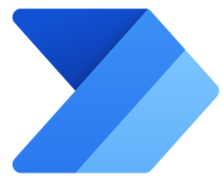

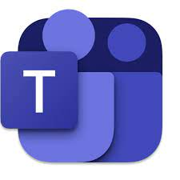
Copilot Studio + AI Search
Chunking, Indexing, Preprocessing
Querying
Data Sources
Knowledge Base
Index
Azure
Azure Storage Account
(to store documents)
Azure Function/
App Service
(Data processing and ingestion)
Azure
AI Search
(Indexes)
(Summary,
Embedding, etc.)
LLM/SLM models
Solution Architecture
Document Intelligence
Azure
OpenAI
Azure
AI Studio
Azure Monitor
Cloud Flow
Users
(Or Logic App)
Generative
Answer
OR
HTTP Request
Interact with Bot
Cloud Flow
Question
SaaS
(Approve/Reject)
Answer
SharePoint Document Library
Approval (within Power Automate)
Copilot Studio
Web Portal
Teams
Communication Channels
Bot

Slide 60




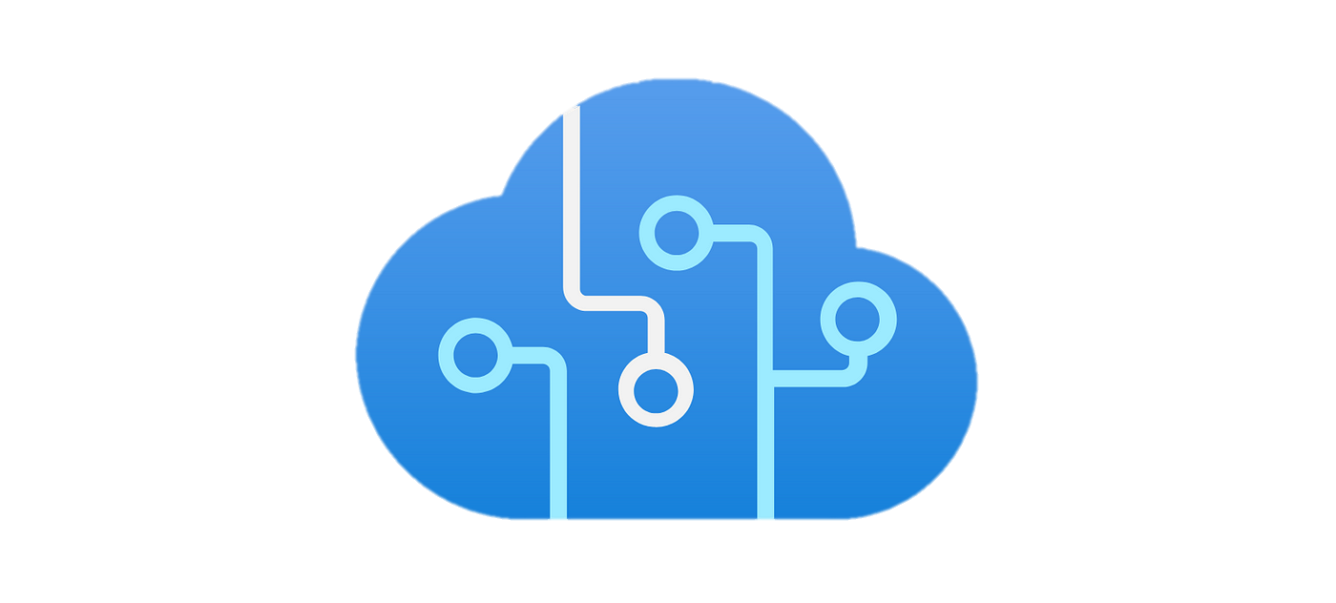




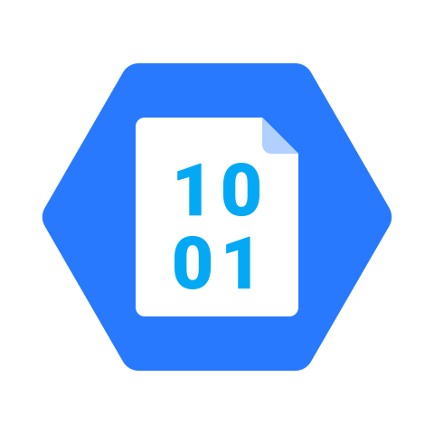
Microsoft Copilot Studio
Search Providers
Message, URLs, Summary (if configured)
Generative Answers Architecture
Azure Cognitive Services Content Moderator
Bing API
Microsoft Graph
Azure Cognitive Services CQA
Azure OpenAI
Dataverse
Customer App Insights
Inside Copilot Studio
IN: Query
OUT: Provider content
IN: Message + content
OUT: Summary
Message
Copilot Studio Runtime
Summary
Published
1
2
3
4
5
6
7
Azure Bot Service Channel
Message moderation
Query optimization
Information retrieval
Summarization
Provenance validation
Summary moderation
Response delivery
Microsoft Copilot Studio Test Chat
Unpublished
State & Feedback Stored < 30 days
Copilot Configuration
No Customer Content
Operational Telemetry
Conversation State Store
AI Feedback Store
Copilot Studio Internal Stores

Slide 61
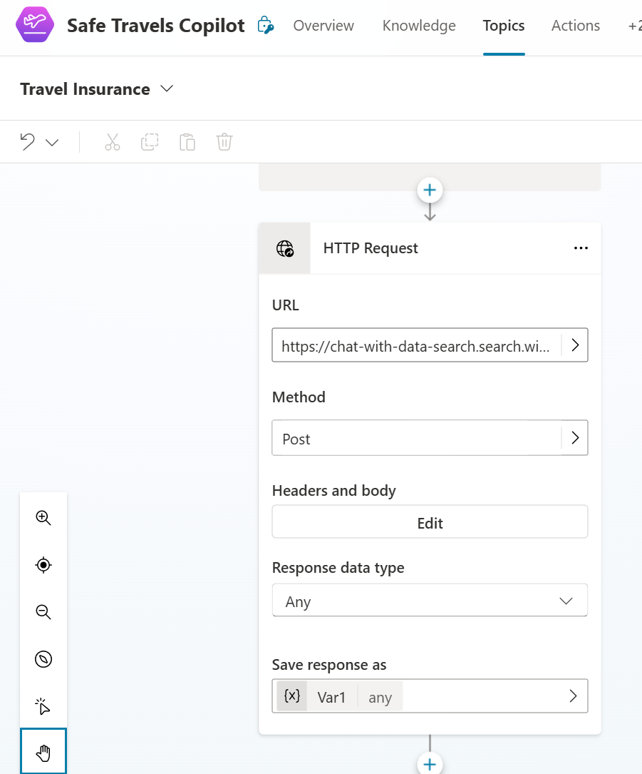
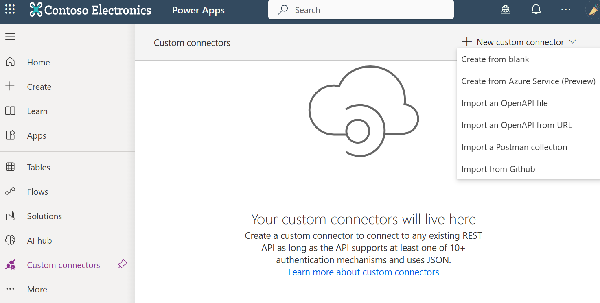
Copilot Studio + AI Search
Using HTTP Request action or custom connector

Slide 62
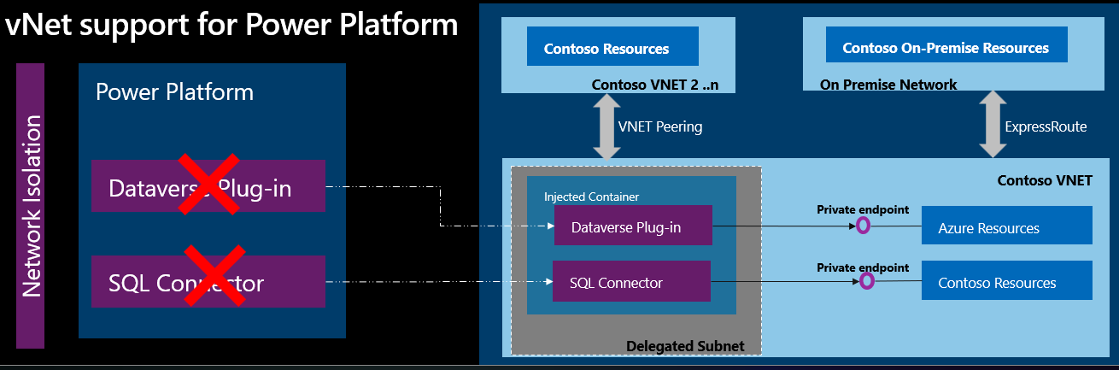
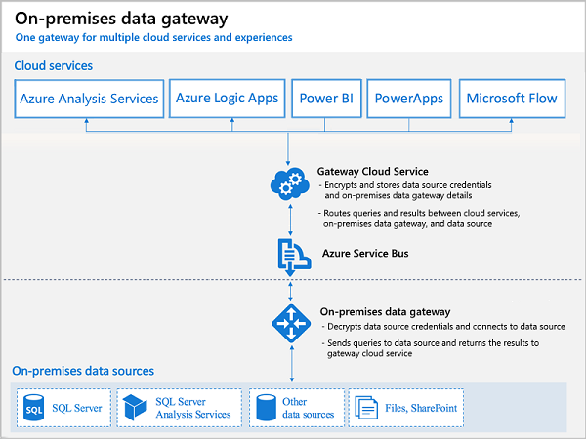
Private Network Traffic
Azure Virtual Network (preview)
Virtual Network support uses Azure subnet delegation to manage outbound traffic from Power Platform at runtime
Virtual Network support for Power Platform overview - Power Platform | Microsoft Learn
On premises data gateway
About on-premises gateways - Power Platform | Microsoft Learn

Slide 63
Azure AI Search Pricing
 | Free | Basic | Standard S1 | Standard S2 | Standard S3 | Storage Optimized L1 | Storage Optimized L2
Storage¹ | 50 MB | 15 GB (max 45 GB per service) | 160 GB (max 1.9 TB per service) | 512 GB (max 6 TB per service) | 1 TB (max 12 TB per service) | 2 TB (max 24 TB per service) | 4 TB (max 48 TB per service)
Max indexes per service | 3 | 15 | 50 | 200 | 200 or 1,000/partition in high density mode | 10 | 10
Scale out limits | N/A | Up to 9 units per service² (max 3 partition; max 3 replicas) | Up to 36 units per service (max 12 partition; max 12 replicas) | Up to 36 units per service (max 12 partition; max 12 replicas) | Up to 36 units per service (max 12 partition; max 12 replicas) up to 3 partitions in high density³ mode | Up to 36 units per service (max 12 partition; max 12 replicas) | Up to 36 units per service (max 12 partition; max 12 replicas)
Price per SU (Scale Unit) | $0/hour | $0.11/hour | $0.34/hour | $1.35/hour | $2.69/hour | $3.84/hour | $7.68/hour
Additional Features
 | Pricing Details
Custom Entity Lookup Skill | 0-1M text records $1 per 1,000 text records 1M-3M text records $0.75 per 1,000 text records 3M-10M text records $0.30 per 1,000 text records 10M+ text records $0.25 per 1,000 text records
Document Cracking: Image Extraction | 0-1M images $1 per 1,000 transactions 1M-5M images $0.80 per 1,000 transactions 5M+ images $0.65 per 1,000 transactions
Semantic ranker | First 1,000 requests per month free. $1 per 1,000 additional requests

Slide 64
Copilot Studio +
Azure AI Studio
“I want it to have the capability to chat with image”
“I want it to have the capability to use custom LLM models”
“I want it to have the capability to have complex AI orchestration flow”
“I want it to have the capability to support chat history”
And more…

Slide 65
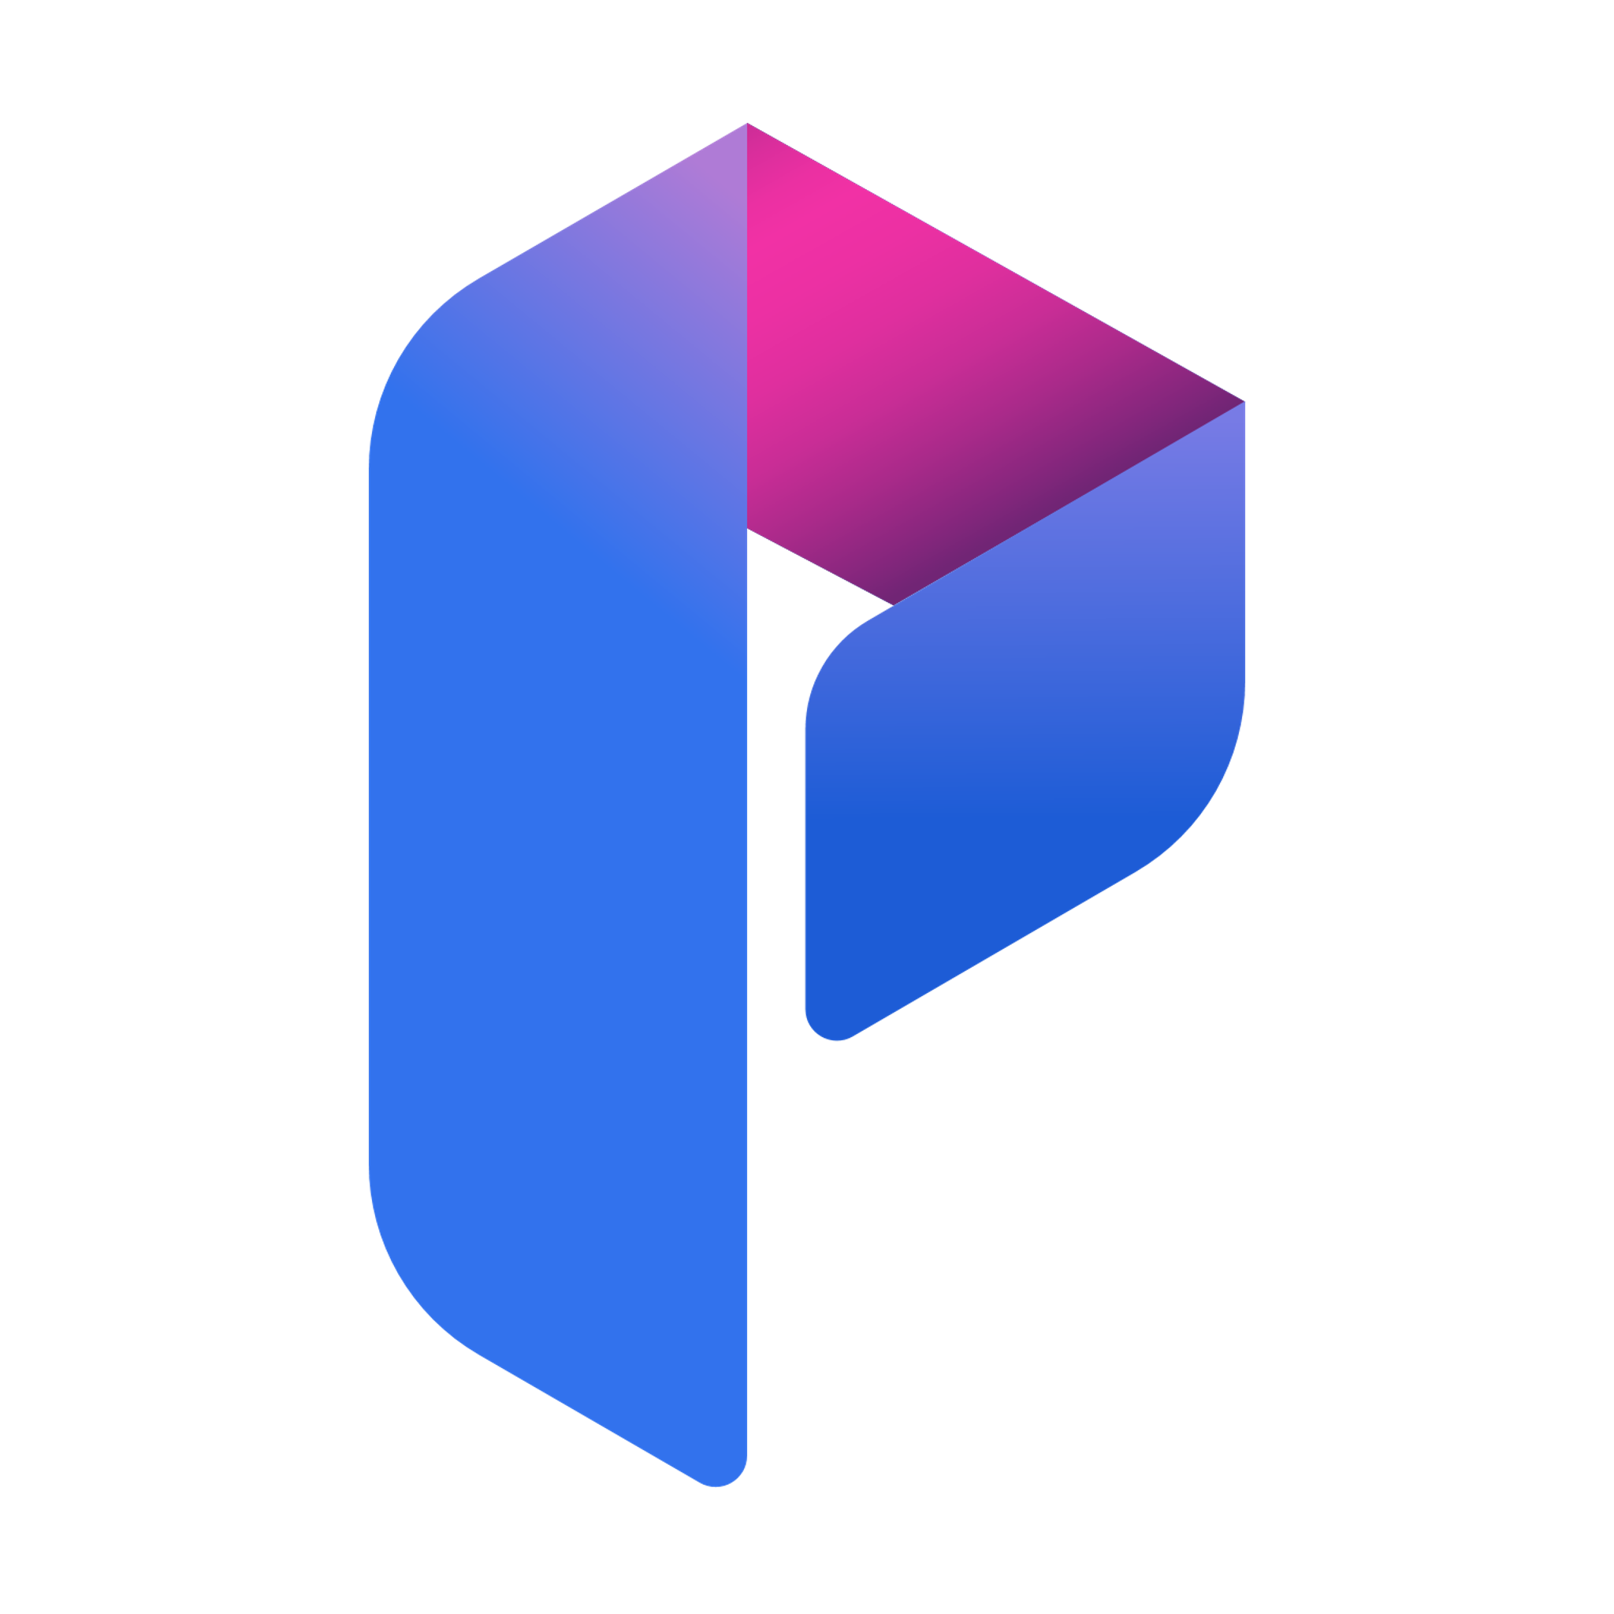
AI orchestration on Azure AI Studio
Chunking, Indexing, Preprocessing
Querying
Data Sources
Knowledge Base
Index
Query
Azure
Azure Function/
App Service
(Data processing and ingestion)
Knowledge
Azure Storage Account
(to store documents)
Azure
AI Search
(Indexes)
Prompt Flow
(AI Orchestration)
Prompt
(Summary,
Embedding, etc.)
Generated Content
Solution Architecture
LLM/SLM models
Document Intelligence
Azure
OpenAI
Azure
AI Studio
Azure Monitor
Cloud Flow
Users
(Or Logic App)
Generative
Answer
OR
HTTP Request
Interact with Bot
Cloud Flow
Question
SaaS
(Approve/Reject)
Answer
SharePoint Document Library
Approval (within Power Automate)
Copilot Studio
Web Portal
Teams
Communication Channels
Bot

Slide 66


AI orchestration on Azure AI Studio with APIM
Chunking, Indexing, Preprocessing
Querying
Data Sources
Knowledge Base
Index
Query
Azure
Azure Function/
App Service
(Data processing and ingestion)
Knowledge
Azure Storage Account
(to store documents)
Azure
AI Search
(Indexes)
App Services
(AI Orchestration)
API Management Service
(Summary,
Embedding, etc.)
Prompt
Solution Architecture
LLM/SLM models
Generated Content
Azure Monitor
Document Intelligence
Azure
OpenAI
Azure
AI Studio
Cloud Flow
HTTP request
HTTP response
Users
(Or Logic App)
Interact with Bot
Cloud Flow
Question
SaaS
(Approve/Reject)
Answer
SharePoint Document Library
Approval (within Power Automate)
Copilot Studio
Web Portal
Teams
Bot
Communication Channels

Slide 67

AI safety and security
Copilot Studio
Microsoft Copilot Studio
Formerly known as Power Virtual Agent
Strong focus on conversational AI / chatbot
Low code & SaaS = accelerated time to market
UX Layer
Microsoft Copilot
Your copilots
Microsoft apps
Orchestration Layer
AI orchestration
Azure AI Studio
Unified experience and one-stop shop for all AI development (beyond copilots)
Model Catalog (AOAI and OSS)
Integration with AI orchestration frameworks such as Prompt Flow, Semanic Kernel, LangChain
Data integration with OneLake in Microsoft Fabric
Built-in content safety
Your data
Intelligence Layer
Foundation models & AI toolchain
AI infrastructure
Microsoft Cloud

Slide 68
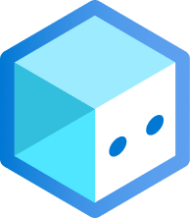
Copilot Studio vs Azure AI Bot Service
Criteria | Microsoft Copilot Studio | Azure Bot Services (previously called Azure Bot Framework)
Licensing | Choose from multiple plans, including Teams Plan, Standalone Plan, and Dynamics 365 integration. | Get it for free with Azure Subscription and choose from message-based pricing options.
Scalability, quotas, and limits | Experience limited RPM and up to 50 bots per Teams app. Scalability is tied to subscription tiers. | Enjoy higher operation limits and dynamic scaling based on demand.
Customization and flexibility | Customize using default canvas with JavaScript or create a custom canvas derived from the Bot Framework Web Chat canvas. | Customize extensively with Web Chat and React.
Development expertise | No to minimal coding experience required. | Advanced customization requires coding skills.
Authentication | Support for multiple authentication providers, including Azure AD v1, Azure AD v2, and OAuth2-compliant identity providers. | Support for Azure AD and OAuth providers.
Data security and compliance | Integrate with Microsoft security features. | Offers robust data security with customer-managed keys using Azure Key Vault.
Optimized for scenarios | No multi-bot support as it can lead to NLP/NLU errors. | Supports complex dialog flows and multi-bot architectures.
Budget constraints | Subscription-based pricing, no-code interface. | Usage-based pricing with some free channels.
Future expansion | Suitable for initial use cases, may have limitations for future expansion as low-code development always encounters challenges post-development regarding updating and maintaining the apps. | Offers room for growth into complex scenarios as it is 100% code-based approach.
Analytics | Offers built-in Azure Application Insights, Power BI, and custom analytics. | Supports Azure Application Insights, Azure Monitor, flexibility to integrate custom analytics solutions using various Azure services and external tools. Integration into Grafana is achievable with straightforward steps. For more information, see Monitor your Azure services in Grafana.
Time constraints | Rapid development with no-code/low-code interface. | Customization may extend development timeline.
Deployment cycle | Simplified deployment and versioning within the interface. | Requires coding, CI/CD, and production deployment.
Microsoft Teams support (task module) | Not natively supported. | Supported.
Microsoft Teams support (messaging extensions) | Not natively supported. | Supported.
Microsoft Teams support (proactive messaging) | Limited support through Power Automate flows. | Supported through Bot Framework.
Deciding between Copilot Studio and Azure Bot Services | Microsoft Learn

Slide 69
Recommendation
Copilot Studio
Rapid development with its no-code interface, templates, co-pilot authoring run-time capabilities, and built-in analytics makes it ideal for projects with time constraints.
Accessible for teams with diverse skill sets, making it suitable for organizations with limited coding expertise.
Subscription-based pricing.
Azure AI Bot Service
Recommended for those who need Teams-specific features like Task Modules, Messaging Extensions, or Proactive Messaging in Microsoft Teams.
Ideal for scenarios involving complex dialog flows, high customization, and multi-bot architectures.
Enables greater customization of UI/UX via the Bot Framework Web Chat component, which is a highly customizable web-based client for the Bot Framework V4 SDK using either JavaScript or React.JS

Slide 70
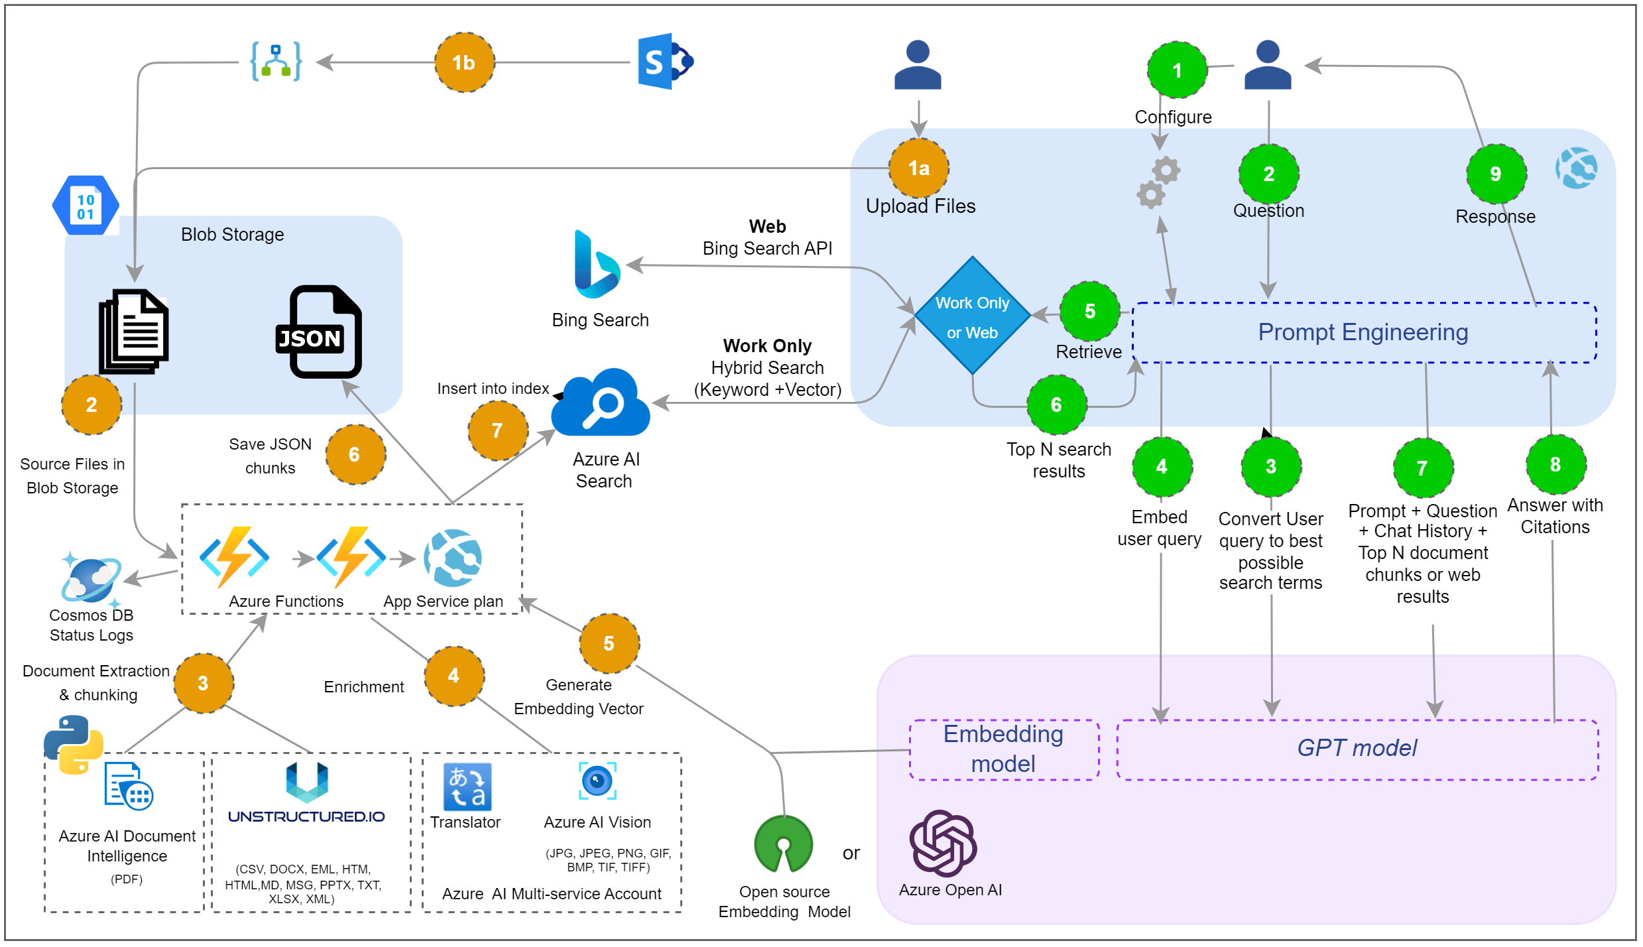
Information Assistant
Terraform template
Provide API only/with UI deployment
Supports
Data from SharePoint
Secure deployment with Private endpoint
Unstructured data handled by unstructured.io
Math assistant
Tabular data assistant
Information Assistant, built with Azure OpenAI Service Accelerator (microsoft.com)

Slide 71
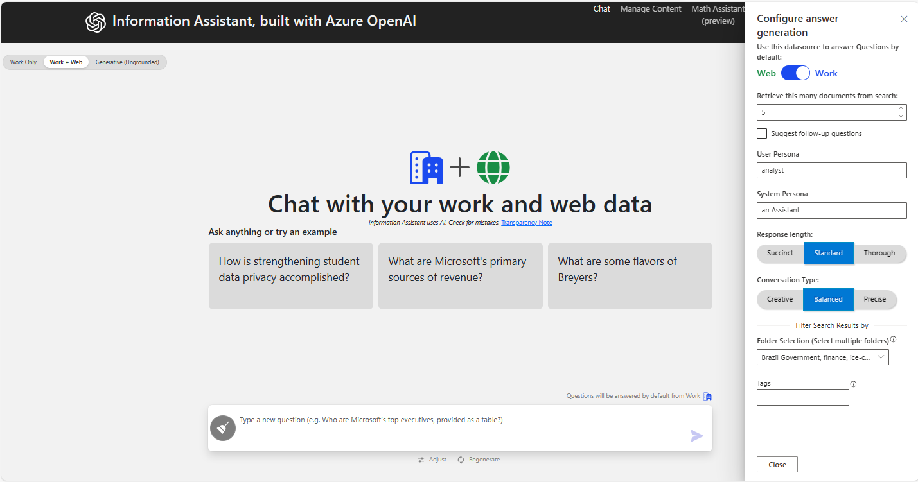
Information Assistant

Slide 72
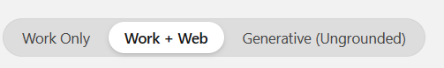
Information Assistant: Three Different Chat Experiences
Work Only
Works exclusively with your own private data.
As a separate UX, there is no chance of accidentally exposing your prompt to an external source
Work + Web
In addition to searching your own data, you have the option of
Searching the Web with the same prompt
Searching both internal and external data sources and providing a response that compares/contrasts both responses
Generative (Ungrounded)
Enables you to interact with the OpenAI service securely without needing your answer to be grounded in either local or web data sources

Slide 73

Information Assistant
Even though our internal sources didn’t have any information we were able to get a response from the Web.

Slide 74

Information Assistant
How many State Parks have wifi and are pet friendly with at least 30 trailer spots available rated a 4 or higher and allow fishing? Please create an appropriate visualization
Note that I never explained what the columns were or how to solve the problem
I never said which visualization to use. I just asked for an appropriate one

Slide 75
Private Data Discovery Challenges
Problem 1: Retrieval augmented generation (e.g. semantic search)
Fails when answers require piecing together information from more than a handful of sources or when the queries are abstract.
E.g. Catch me up on the last two weeks of emails.
Problem 2: Large context window model (e.g., 1MM+ tokens)
Fails when scale of dataset is too large and because of "lost in the middle" phenomenon
E.g. What creatures are discussed in this podcast series?
Solution: GraphRAG. A scalable, summary-based data index
“Graph base Retrieval Augmented Generation” by Bing Image Creator

Slide 76






Preprocessing Pipeline – Graph Enabled RAG
Dataset Question Generator
Summarized Q&A
Etc.
Information Extraction
Graph Induction
POK leader Sylvia Marek took the stage with Lucio Jakab, founder of Save Our Wildlands
Text Chunks
GraphRAG
GraphRAG
Private Dataset
Graph ML
- Topic Detection
- Representation Learning
Hierarchy Extraction
Graph Embedding
Entity Summarization
Community Summarization
- Too large for context window
- “Semantic Search” works, but we know nothing of the dataset!
GraphRAG
GraphRAG
Semantic Search DB
Baseline RAG
Text Chunks
(to Ada)
More layers…
GraphRAG
Entity Content
Level 0 community
Level 1 communities
Level 2 communities
Semantic Summary
microsoft/graphrag: A modular graph-based Retrieval-Augmented Generation (RAG) system (github.com)

Slide 77

Demo: Tech Podcast from the Event

Slide 78

GraphRAG Accelerator
https://github.com/Azure-Samples/graphrag-accelerator

Slide 79
More than Azure AI Studio
“I need to access to full spectrum of Azure AI services and even open sourced/3rd party AI models to generate post-event marketing material and insight report.”

Slide 80
Build copilots your way.
Microsoft Copilot Studio
Azure AI Studio
Why not both
More than both

Slide 81



Recap: What AI studio can offer?
Fine tuning AI model via AI studio
LLMOps with prompt flow and Azure DevOps in Azure AI Studio
Demo (model catalog, AI content safety, evaluation and monitoring)

Slide 82
Enterprise Gen AI app High-level Architecture
Enterprise chat
Select your chat model
Add and index your data
Calibrate your prompting logic
Deploy and monitor usage
GPT-4
Azure OpenAI Resource
DEFAULT
Import Data
Blob Storage, S3, GitHub, unstructured files
Customize System Prompt
Ensure appropriate RAI Compliance before deployment
ChatGPT
Azure OpenAI Resource
Azure AI Search
Keyword, Vector, Hybrid, Ranking
DEFAULT
Establish retrieval augmenting search connector
Deploy enterprise chat solution endpoint
Llama 2
Meta
Fabric
Flow Connection Tool available
Add prompting examples
Monitor token consumption and adjust solution parameters accordingly
Model Catalog
OSS LLM Model offerings
MS Graph
Flow Connection Tool available
Add flow tools and plugins
Fine-Tuned LLM
Any LLM in your collection you previously fined-tuned.
External Vector Database
Measure effectiveness with manual and metric evaluations
Monitor compute and resource metric costs over time and optimize solution infrastructure as needed
If additional calibration required, consider fine tuning your own model

Slide 83

Evaluating and monitoring of generative AI applications

Slide 84









Azure AI
Azure AI Studio
Azure AI Services
Better Together e.g. Generate marketing content, post event eDM, event insight report
Azure AI Document
Intelligence
Azure OpenAI Service​
Azure AI Language
Azure AI Translator
Structured & Unstructured
Text Extraction
Content Generation
(Text, Code, Image)
Natural Language Processing & Text Analytics
Real-time Document
& Text Translation
Azure AI Content Safety
Azure AI Search
Azure AI Speech
Azure AI Vision
Content Moderation
(Text, Code, Image)
Vector & Text-based Information Retrieval
Recognize, Synthesize, Translate & Transcribe Speech
Image & Video Analysis, such as OCR, Face, Spatial
Azure Machine Learning
Cutting-Edge Models
Azure AI Infrastructure
Regulatory Compliance
CSA
FedRAMP
GDPR
HIPAA
HITRUST
ISO
PCI
SOC
US DoD
84

Slide 85



More than AI studio
Data x AI x App
Tap into full spectrum of data and AI service from Azure with enterprise grade security and responsible AI in place
More than AI, it is about problem solving. Your business is only as good as your data

Slide 86


Enterprise-grade Production at Scale
Deploy AI innovations to Azure's managed infrastructure with continuous monitoring and governance across environments
Enable developer agility and enterprise governance at scale
Deploy to production
Operationalize and monitor
workflows
Scale AI for use in websites, applications, and other production environments.
Continuously monitor AI safety, quality, and token consumption in production. Automate workflows and alerts for timely issue resolution.
Provide easy project creation and resource management across the organization and enterprise controls for security, privacy, and compliance.

Slide 87

Azure OpenAI chat baseline architecture in an Azure landing zone - Azure Architecture Center | Microsoft Learn

Slide 88

Azure OpenAI Landing Zone reference architecture

Slide 89







Enterprise Promises in Azure AI Studio
Network Isolation
Identity & Access Control
Data Protection
Policies & Monitoring
Quota & Cost Management
Planning & Deployment
Managed VNET, private link support, logging
Managed identity,
AAD, RBAC, ABAC
Encryption – at rest
and in transit
Azure Monitor and Azure Policy integrations
Budgeting, auditing, and shared quota tools
Infra as Code and landing zones templates
Platform Trust
Microsoft Fabric and Azure AI Studio + Copilot Studio integration
Data protection, GDPR compliance, transparency on OS/container updates, and vulnerability management

Slide 90


Slide 91

Thank you!
Join Us to get the latest update.
Scan to join Microsoft Hong Kong Partner Group.

